Slide 1
Orexin Neurocircuitries driving Susceptibility and Resilience to Stress
Cliff H Summers
BIOL 792 Topics: Brain Stress Circuitries: Orexin Connections
21 February 2024

Slide 2
Physiological and Behavioral Stress Responses are Regulated by Specialized Neurocircuits in Brain Regions activated by Emotion
Theme Slide
Understanding the neurochemistry and anatomy of these circuits brings clarity to the behaviors and emotional states that they produce

Slide 3
1. Stress → oxidative, cellular, neural, endocrine, emotional → strain/tension on normal homeostatic range 2. Stress Neurocircuitry → Sensory-Regulatory-Motor neurons in series producing controlling emotional, behavioral, and neuroendocrine distress 3. Orexins / Hypocretins (Orx / Hcrt) → 2 peptides made in the Perifornical Hypothalamus
Main Characters
We will examine the relationships between these ideas

Slide 4
Orexin/Hypocretin Neuropeptides
Background
Orexin A (Orx_{A} = Hcrtr1) & Orx_{B}= Hcrt₂
Cleaved one prepro-Orx gene
Orexin = stimulate feeding
Hypocretin = hypothalamic secretion
Orx_{A} = 33 aa Orx_{B} = 28 aa
~50% sequence similarity
Excitatory function
Prepro-orexin
Orx_{A}
Orx_{B}

Slide 5
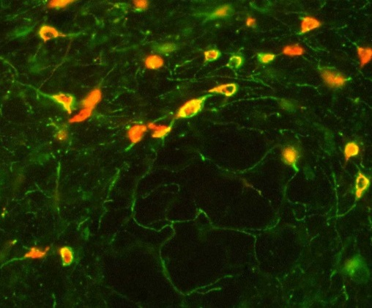
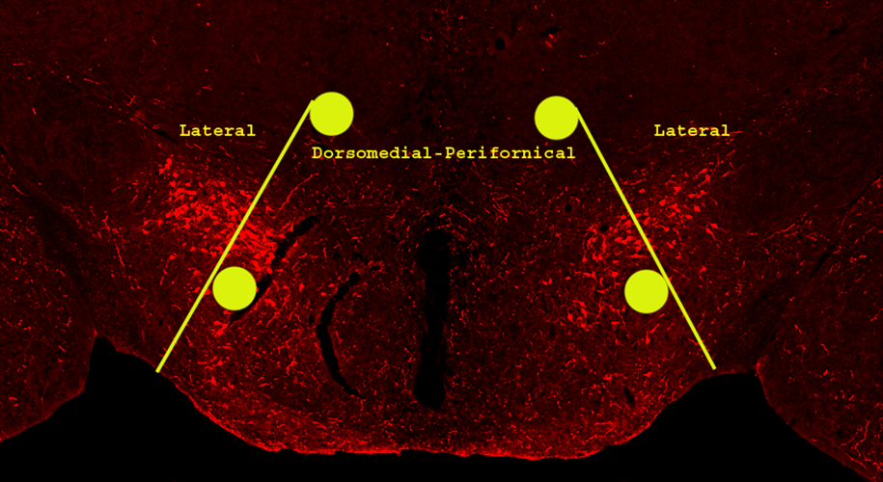
Orexin Synthesis Site
Background
Fornix
C-shaped bundle of axons
Major output tract of Hippocampus
Between Hippocampus & Hypothalamus
Perifornical Area (PeF)
Contains Orx/Hcrt neurons
Laterally – LH lateral hypothalamus
Medially
– DMH dorsomedial hypothalamus
Fornix

Slide 6
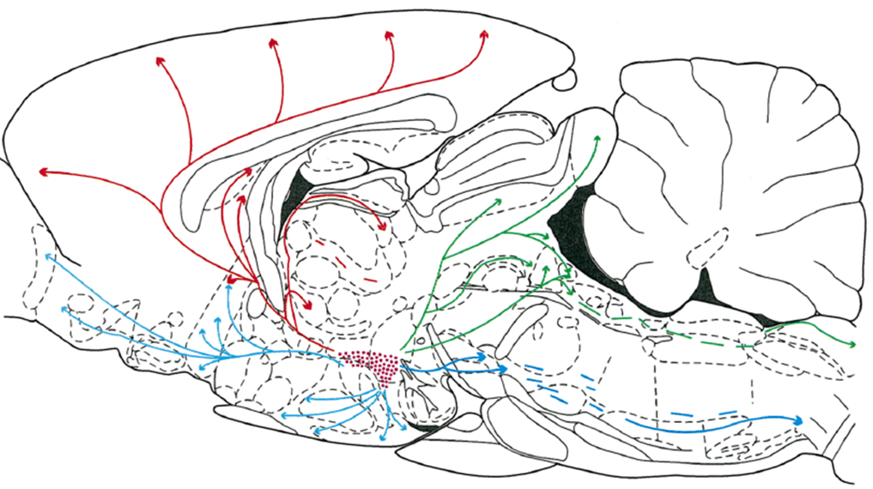
Hypothalamic (LH – DMH/PeF) Orexin Synthesis
Background
Fornix

Slide 7
Orexin Neurons
Also contain:
1. Glutamate (Glu)
excitatory
2. Dynorphin (Dyn)
opioid
inhibitory

Slide 8
Orx Receptors – 2 types
Orx₁ receptors
G_{q/o} → PLC → PIP₂ → IP₃ → Ca⁺⁺
DG → PKC
2-AG
Excitatory
Orx₂ receptors
G_{q/o} → PLC → PIP₂ → IP₃ → Ca⁺⁺
DG → PKC
2-AG
Excitatory

Slide 9
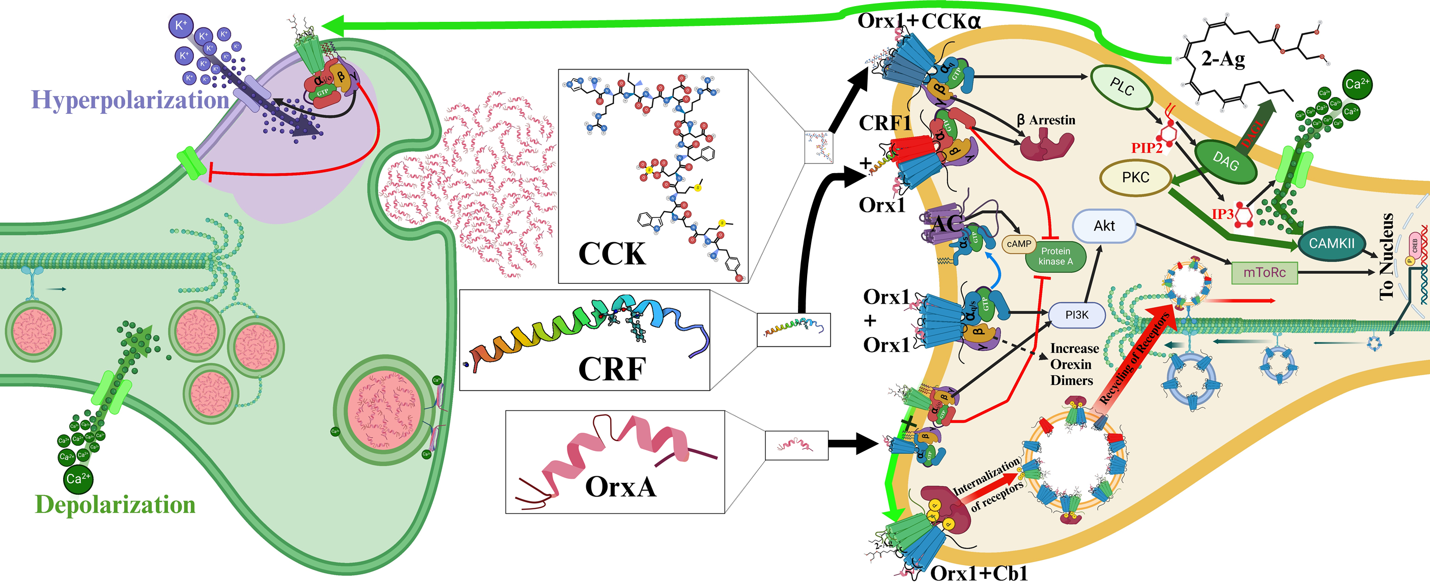
Receptor homo- and heterodimers

Slide 10
Orx Receptors Affinity – 2 types
Orx₁ receptors
Binds both Orx_{A} and Orx_{B}
Half maximal effective concentrations
Orx_{A} = 30 nM
Orx_{B} = 2500 nM
Orx₂ receptors
Binds Orx_{A} and Orx_{B} with equal affinity
½ max EC Orx_{B} = 36 nM
½ max EC Orx_{A} = 38 nM

Slide 11
Orx Receptor Actions
Orx_{A} and Orx_{B} made simultaneously
From separate sequences
Of one Prepro-orexin peptide
Released in equivalent amounts
Thus, Orx_{A} drives most Orx₁ Receptor Actions
With a small contribution from Orx_{B}
Orx_{B} would act on ~500 receptors/cell
Orx_{A}-Orx_{B} together drive Orx₂ Receptor Actions

Slide 12
Hypothesis: Due to the Flexibility and Neuroplastic Nature of Orexin Activity Stress States and Behaviors may be Regulated Positively and Negatively
Hypothesis Page
1st Key to Neuroplasticity:
Diverse Behavioral Function

Slide 13
Where do Orexins Act?

Slide 14
Orexin Functions
Derive from Regional Receptor localization
And… some distinction in LH – DMH/PeF outputs
Two original Functions:
1. Feeding
2. Sleep/Wake

Slide 15
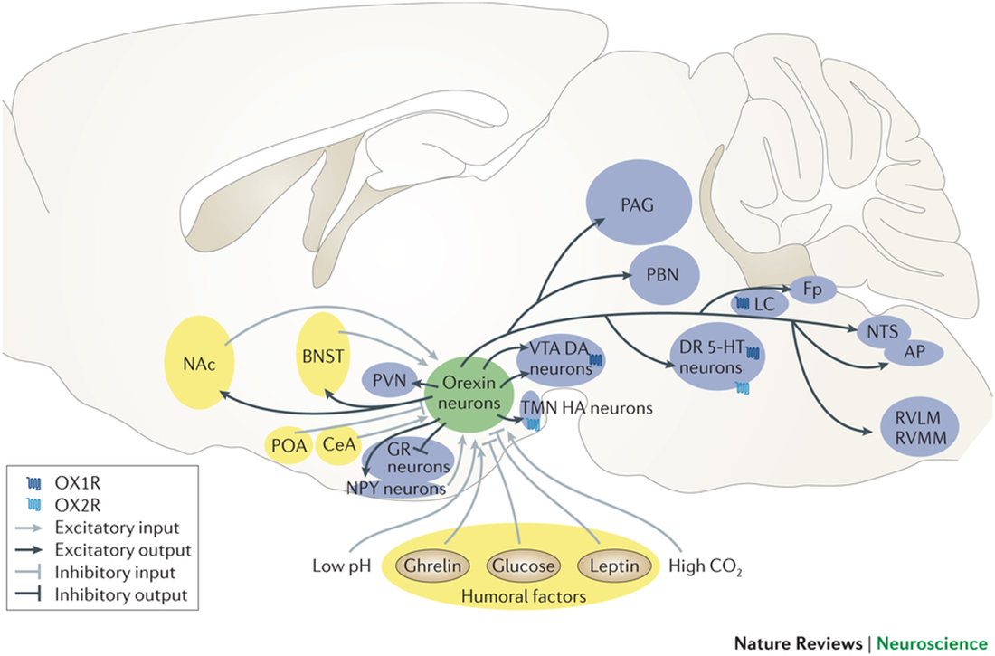
Orexin Functions
LH Orx neurons
Sensitive to Food
Glucose
Food Related Hormones
Ghrelin
Leptin
H or D neurons
Hyperpolarized by Leptin
Depolarized by Leptin
IGF₁ Receptors
Growth mediator

Slide 16
Orexin Functions
LH Orx neurons Projections
to Hypothalamic Feeding Areas
VMH (ventromedial Hypothalamus)
Inhibit Glucoreceptor neurons
Glucose inhibits Orx
Within LH
MCH neurons – promote feeding
ARC (Arcuate Nucleus)
Leptin (fat) sensors
NPY neurons – promote feeding
MCH = melanocyte
concentrating hormone
NPY = Neuropeptide Y

Slide 17
Orx and Body Weight
While Orx increases feeding
Peripheral/Central Orx₂ Receptors
Increase Energy Expenditure
Reduce Body Weight
Increase Leptin-induced
anorexia and catabolism

Slide 18
Because Orx regulates Food Seeking
Orx also regulates/promotes:
Reward Seeking
Hedonic Reactions
Expectation
Satiety
Disappointment
Addiction
Withdrawal
Relapse
Motivation

Slide 19
Food/Reward/Motivation
Are closely linked to Stress

Slide 20
DMH/PeF projections promote Wakefulness

Slide 21
Orexin Regulation of Sleep and Waking
Orx neurons less active during sleep
DMH/PeF Orx neurons activated during wakefulness
DMH/PeF Orx neurons fire just before Waking
“Cause” waking within several seconds
Not direct causality
Not an On-Off switch
increases probability of sleep to Wake transitions
lengthens the duration of Wakefulness

Slide 22
How Orexin Regulates Waking
SCN = suprachiasmatic nucleus
(circadian biological clock)
Stimulates DMH/PeF Orx neurons
during active periods
DMH/PeF stimulate multiple arousal areas
Basal forebrain, PPT/LPT, locus ceruleus, raphe, TMN,
Activates ACh, NE, 5-HT, HA arousal signals
To activate all neurocircuits in the brain

Slide 23
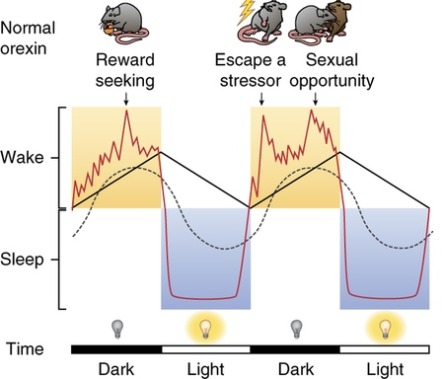
Because Orx regulates Waking
Orx also regulates/promotes:
Arousal
Stress
Anxiety
Panic
Depression
Anorexia, OCD, Bipolar disorder…
PTSD
Withdrawal/Relapse in Addiction
Motivation

Slide 24
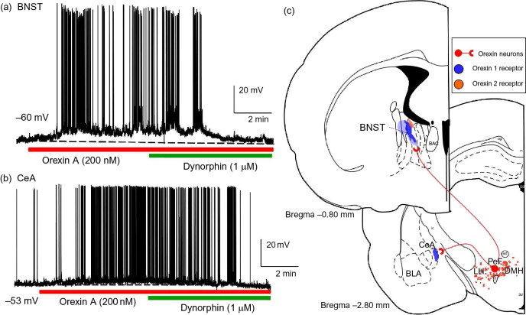
Orexin directly activates Anxiety Centers

Slide 25
Stimulation of the DMH/PeF can cause Panic

Slide 26
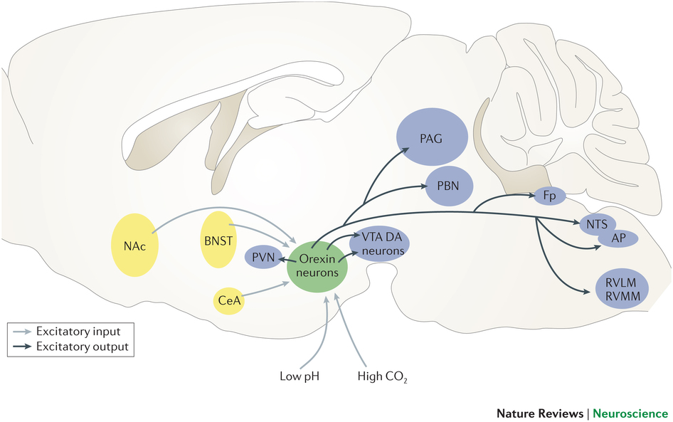
Because Orx regulates Waking/Stress
Orx also regulates/promotes:
Autonomic Function
Links Limbic to Premotor Autonomic Centers
Paraventricular N, Periaqueductal Gray, Parabrachial N, N Solitary Tract, Area Postrema
Increasing Sympathetic Activation
Increasing HR and BP
Respiratory Function
Fight or Flight Responses

Slide 27
Orexin System Plasticity
Working through numerous
other brain systems
Tying together Related
behavioral and physiological
functions

Slide 28
Acted on by Numerous Inputs

Slide 29
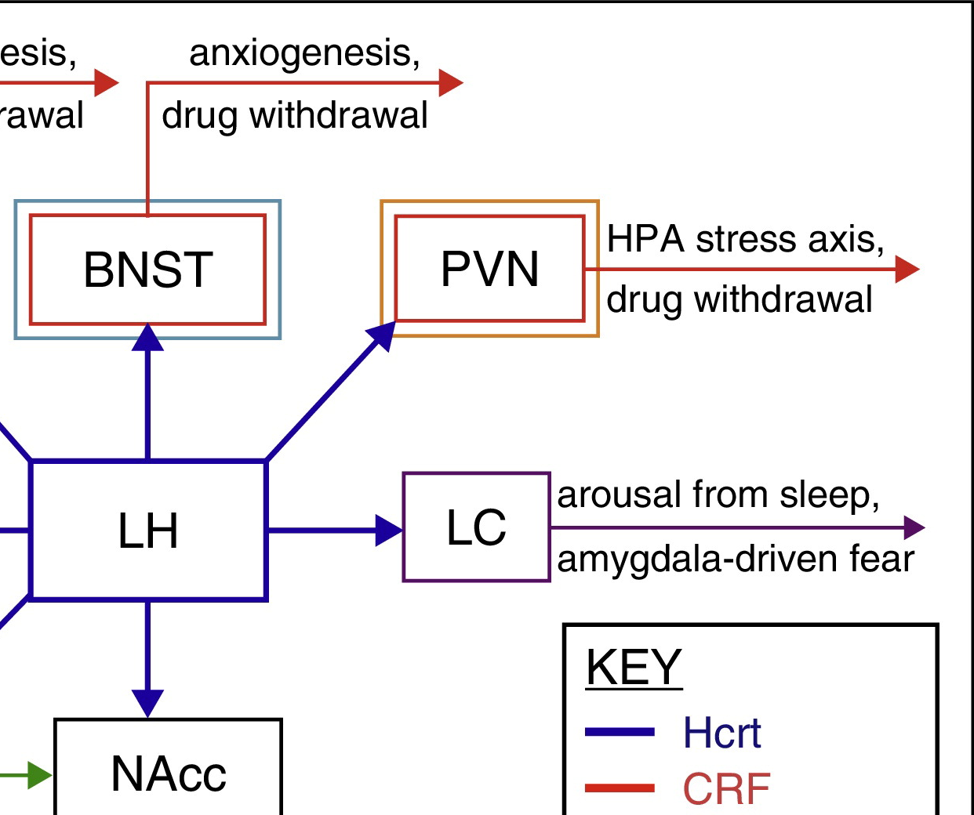
Orexin Activation of Stress Hormones
DMH/PeF Orx innervates PVN CRF neurons
Reciprocal CRF to DMH/PeF innervation
CRF = corticotropin releasing factor
Stress Hormone Axis (HPA)
CRF
ACTH (adrenocorticotropic hormone)
Cortisol
Peripheral Orx stimulates
ACTH and Cortisol

Slide 30
Plasticity and Stress Neurocircuitry
CRF is the major central peptide regulating stress
Neuronal CRF made in PVN, BNST, and CeA
BNST = Bed Nucleus of the Stria Terminalis, CeA = Central Amygdala
BNST/CeA: CRF + GABA but PVN: CRF + Glu
Orx innervates all CRF centers
All reciprocal innervations
CRF excites Orx neurons
Orx activates CRF neurons

Slide 31
Plasticity and Stress Neurocircuitry
Orx activates CRF neurons
promotes anxiety / stress
via Orx₁ and Orx₂ receptors
exciting (G_{q}-PLC-PIP₂- IP₃ – Ca⁺⁺) the same neurons
in BNST and CeA
But… basolateral amygdala
BLA innervates CeA
in BLA Orx₁ and Orx₂ receptors
are on different neurons
with different functions

Slide 32
Plasticity and Stress Neurocircuitry
BLA Orx₁ receptors stimulate excitatory Glu neurons
pro-stress… increase anxiety
BLA Orx₂ receptors stimulate inhibitory GABA neurons
anti-stress… decrease anxiety
Receptors differentially
regulate gene expression
In stress-resilient mice
Blocking Orx₁R action
reduces Orx₁R (Hcrtr1) and PLC (Plcb1)
gene expression

Slide 33
Plasticity and Stress Neurocircuitry
In stress-vulnerable mice
Blocking Orx₁R action makes them more resilient
and increases Orx₂R gene expression
Hcrtr2
increases brain derived neurotrophic
factor (Bdnf) expression
BDNF stimulates neuroplasticity/learning
and
changes PLC to ERK₁ signaling
or at least increases Mapk3 expression

Slide 34
Take Home Messages
A) Orexins act Neurally and Hormonally
B) Orexins have multiple functions
1. Behavioral Plasticity
2. Physiological Plasticity
3. Molecular/Signaling Plasticity
C) Due in part to broad distribution of 2 receptor types
1. Which sometimes reside on different types of neurons
2. Resulting in varying functions
D) and numerous projections to LH and to DMH/PeF
E) Thus, Neurocircuitry matters to Function

Slide 35
Conclusions
1. Specific Orexin Stress-Related Neurocircuitries result in very different outcomes
2. While Orexins are generally thought of as Pro-Stress, they can also be anti-stress depending on the circuitry
3. Changes in Molecular Signaling and Gene Expression likely play important roles in Neuroplastic Function

Slide 36
Thanks

