Slide 1
Addicted to Rewards The STRESS associated with REWARD SEEKING and addiction
Megan John
BIOL 792 Topics: Brain Stress Circuitries: Orexin Connections
28 February 2024

Slide 2
Theme
Oxytocin and Orexin Systems bidirectionally regulate reward-seeking behaviors in addiction
via a pool of reserve Orexin neurons

Slide 3
Main Characters
Oxytocin (OXT)
Produced in Paraventricular Nucleus of the hypothalamus (PVN)
Role in parturition, maternal behaviors, social reward and stress responsivity
Orexin (Orx)
Role in arousal, wakefulness, feeding, acts on stress and reward circuitry
Adjust capacity for peptide production → Orx reserve pools
Paraventricular Nucleus of the hypothalamus (PVN)
Mediates appetite and stress responsivity
Inputs from CRH, Orx, OXT, and more!

Slide 4
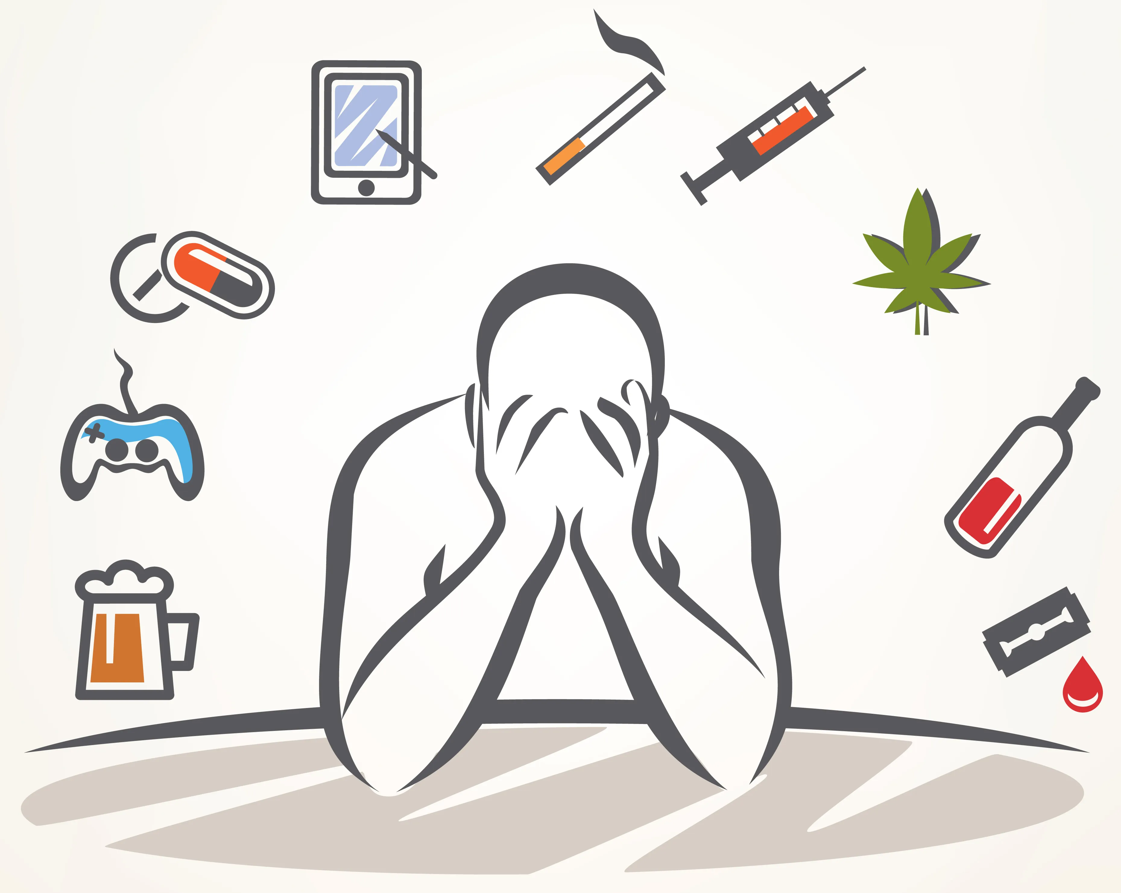
What is Addiction?
Physical and mental dependence on a specific substance
Food (sugar, caffeine, etc.)
Alcohol
Drugs (cocaine, heroin, nicotine, opium, methamphetamines)
Gambling
Social media

Slide 5
What is Addiction?
Factors that influence addiction
Environment
Genetics
Chronic disease
Difficulties with self-control (relapses; overdoses)
Addictions hijack the REWARD SEEKING circuit!
Nature Nurture
Impacts Development

Slide 6
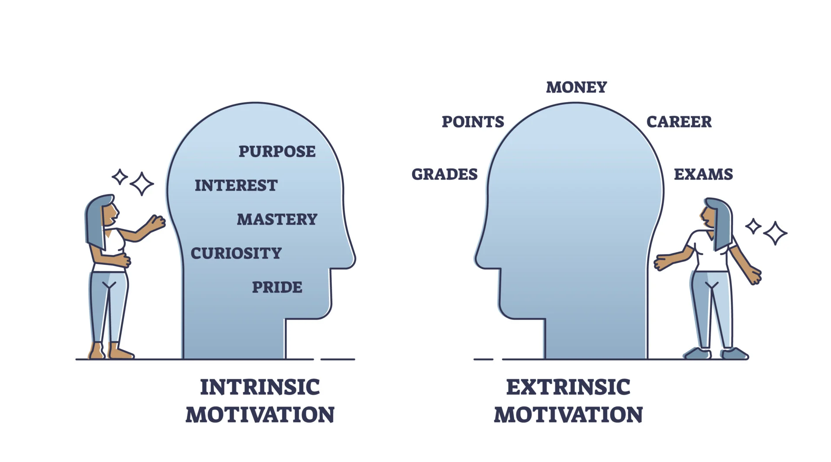
What is REWARD SEEKING?
Behaviors done to obtain pleasure
Intrinsic vs Extrinsic
Reward processes critical for survival!
Positive vs Negative Reinforcements
Reward feeling generated by Oxytocin release
Notes:
Anything we do in order to obtain pleasure or satisfaction or approval from others is 'reward seeking' and almost all our behavior is extrinsically driven in this way.
Reward processes crictical for survival, such as eating drinking and mating, however, there must be balance and control or else disorders arise, like addiction.
Positive reinforcement generally refers to the pleasant feelings and social enhancement effects that alcohol provides, while negative reinforcement encompasses relief from negative affective states like stress or anxiety.

Slide 7
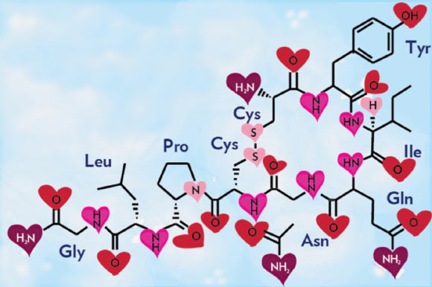
Oxytocin (OXT)
OXT = “happy hormone” or “love drug”
Satisfaction, reward, social interaction, reproductive system
OXTRs on Dopaminergic neurons in VTA
Impacts Addictive behaviors
Could OXT treat Addiction?

Slide 8
OXT associated with Social Reward
After social interaction, ↑ PVN neurons expression of c-fos
What also impacts OXT + Addiction? → Stress
Notes:
After social interaction, ↑ PVN neurons projecting to VTA expressing c-fos, a marker for neuronal activity
Ai14 is a Cre report
er tool strain designed to have a loxP-flanked STOP cassette preventing transcription of a CAG promoter-driven red fluorescent protein variant (tdTomato)
Hung et al. (2017). Gating of social reward by oxytocin in the ventral tegmental area. Science.357(6358):1406-1411

Slide 9
How is Stress Involved?
Managing stress looks different for everyone
Different levels of stress
Low
High
Low level of stress; able to relax after brief stressor
Moderate level of stress; stress state persists for few hours/days
Chronic Stress; persist for extended time weeks/months
Addiction
Drug choice → drug cues → drug seeking

Slide 10
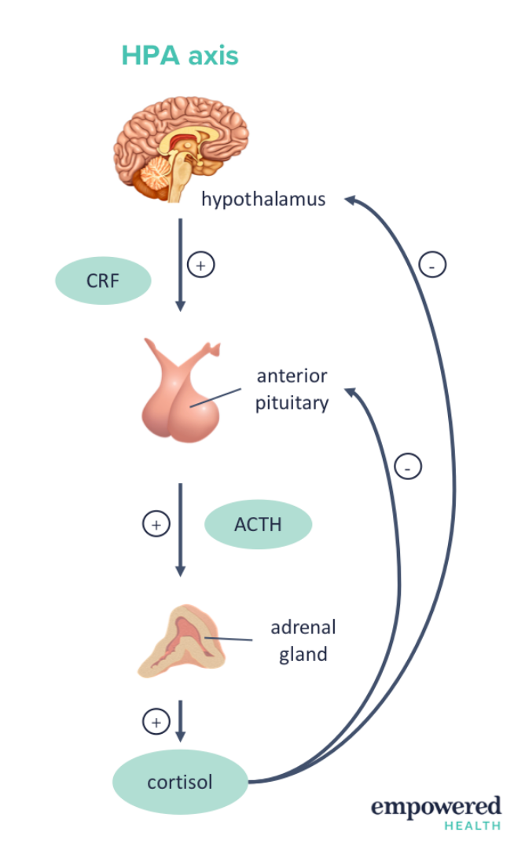
How is Stress Involved?
Stress Endocrine Axis
Hypothalamic-Pituitary-Adrenal Axis
CRH → ACTH → Cortisol
Modulation of the Stress Pathway
Orexins
Orx_{A} + Orx_{B}
Orx₁ + Orx₂
https://empoweredhealthinstitute.com/what-is-the-hpa-axis/

Slide 11
Hypocretins / Orexins (Orx)
Orexin functions regulate:
Arousal
Wakefulness
Appetite (Hypocretins)
Orexins modulate other circuitries!
Noradrenergic (NE/Epi)
Cholinergic (Ach)
Serotonergic (5-HT)
Dopaminergic (DA)
HPA (Cortisol)
https://link.springer.com/chapter/10.1007/978-3-319-23739-8_2

Slide 12
Optogenetic stimulation of LH Orx inputs in VTA
Notes:
Mice received bilateral infusions of either channelrhodopsin or mCherry (control)
Grafe LA, Bhatnagar S. Orexins and stress. Front Neuroendocrinol. 2018 Oct;51:132-145. doi: 10.1016/j.yfrne.2018.06.003. Epub 2018 Jun 19. PMID: 29932958; PMCID: PMC6345253.

Slide 13
Orx inputs in VTA Promote Pavlovian Food Cues
Orx impacts addiction and reward → targets stress pathway
Notes:
LH Orx inputs in VTA Promote Pavlovian food cues
mCherry = control
ChR2
mCherry and ChR2 mice received significantly more cue presentations during the post-conditioning cue value test (filled bars) compared to pre-conditioning baseline cue value assessment (open bars). There was no difference in the number of cue presentations between mCherry and ChR2 mice. F mCherry and ChR2 mice made significantly more active-inactive lever presses during the post-conditioning cue value test (filled bars) compared to pre-conditioning baseline cue value assessment (open bars). There was no difference in the number of active-inactive responses made for the cue between mCherry and ChR2 mice.
More stress after conditioning (Post) = more activation of level presses

Slide 14
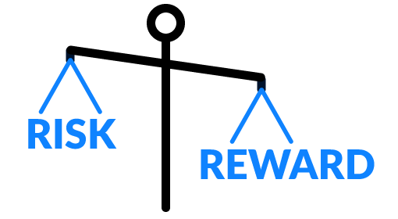
STRESS, addiction & REWARD SEEKING
Balance needed to avoid extreme effects
Development of addictions
Chronic stress
Repeated exposure to addictions + chronic stress
Dysregulation of reward and stress circuitry

Slide 15
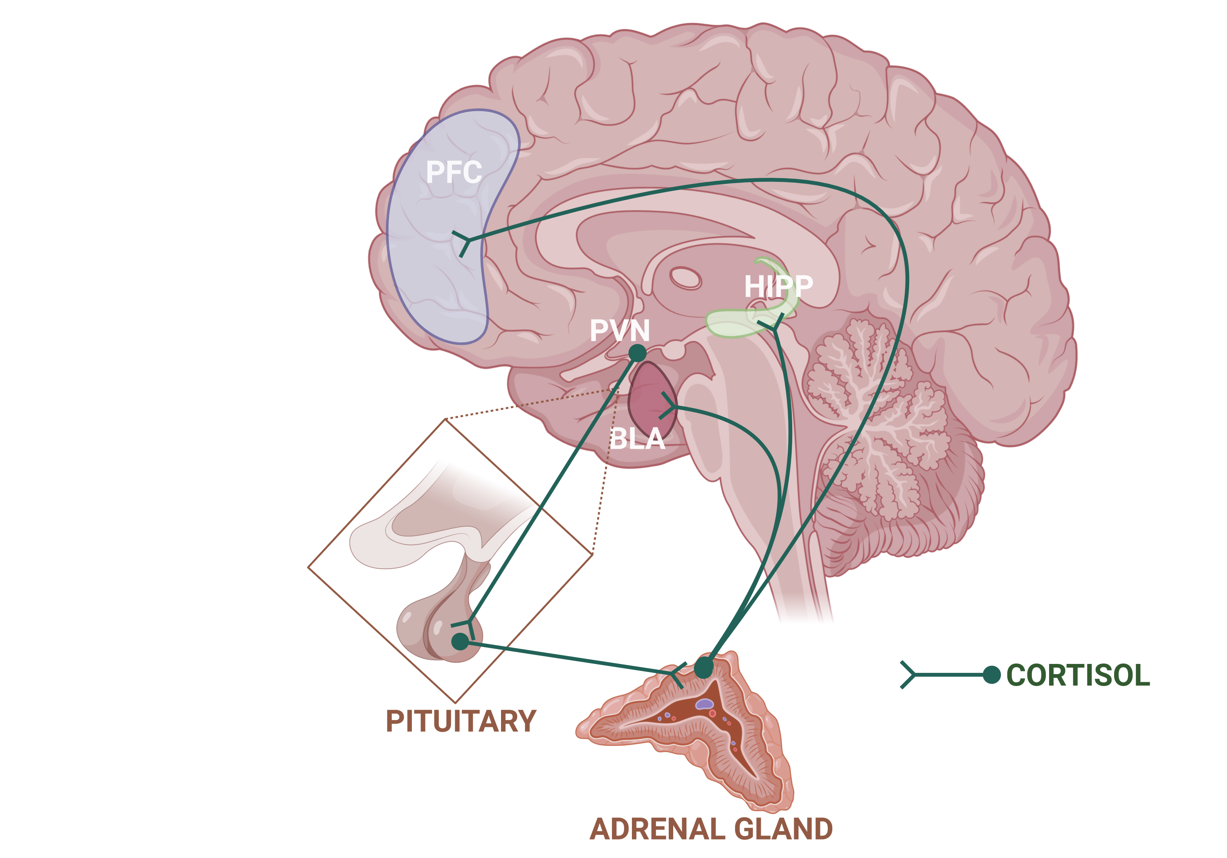
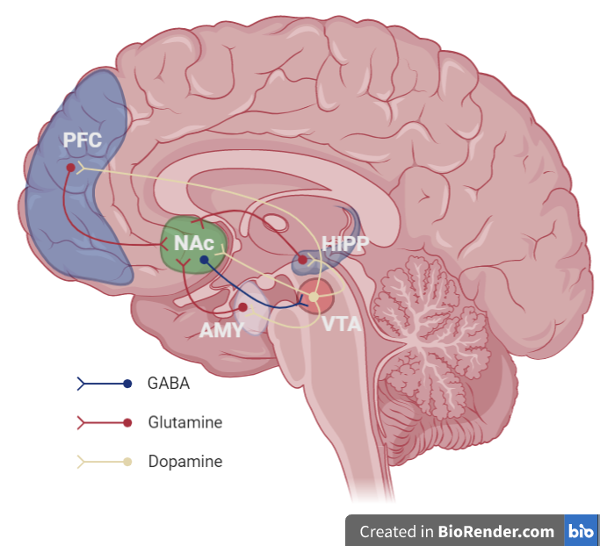
Stress vs Reward Circuitry
Also, OXT!
Notes:
https://en.wikipedia.org/wiki/Reward_system#/media/File:Mesocorticolimbic_Circuit.png
Image created with BioRender

Slide 16
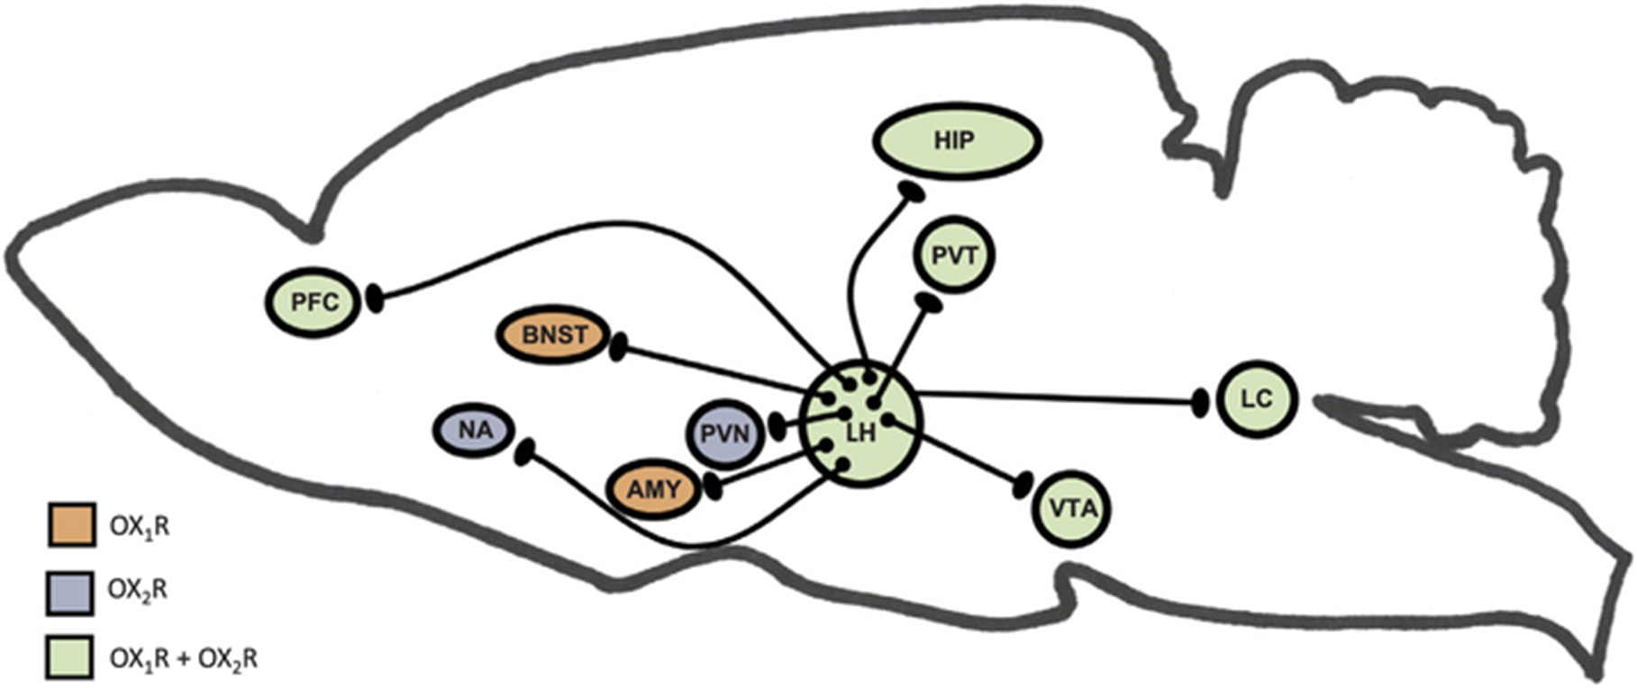
Orexin Circuitry
Notes:
Grafe LA, Bhatnagar S. Orexins and stress. Front Neuroendocrinol. 2018 Oct;51:132-145. doi: 10.1016/j.yfrne.2018.06.003. Epub 2018 Jun 19. PMID: 29932958; PMCID: PMC6345253.

Slide 17
Stress vs Reward Circuitry
Does stress influence the reward circuitry? or …
Does addiction/reward influence the stress circuitry?
PFC
Amygdala
(CeA + BLA)
Hippocampus
BNST
Raphé Nucleus
PVN
Reward Circuitry
Stress Circuitry
Pituitary gland
Adrenal gland
VTA
NAc
Basal Ganglia
CRF/CRH
POMC
ACTH
Cortisol (F)
Urocortins
Dopamine (DA)
OT/OXT
5-HT
NE/Epi
Orx
Opioids
What other modulators are involved?
Notes:
OXT and Orx use the same signaling pathway (PLC). Dysfunction with PLCβ1 isoform implicated in stress and addiction!

Slide 18
What Is Known?
Stress, Addiction, Reward…
“Oh My!”
Stress, Addiction, Reward go hand-in-hand!
Modulated by the Orexin Circuitry
Long-term exposure impacts:
Learning
Judgement
Decision-making
Memory
Behavior
Rise in specific addictions
Opioid Use Disorder
Notes:
Stress, Addiction, Reward go hand-in-hand!
Long-term exposure causes changes to brain signals and circuits and impacts:
Learning
Judgement
Decision-making
Memory
behavior

Slide 19
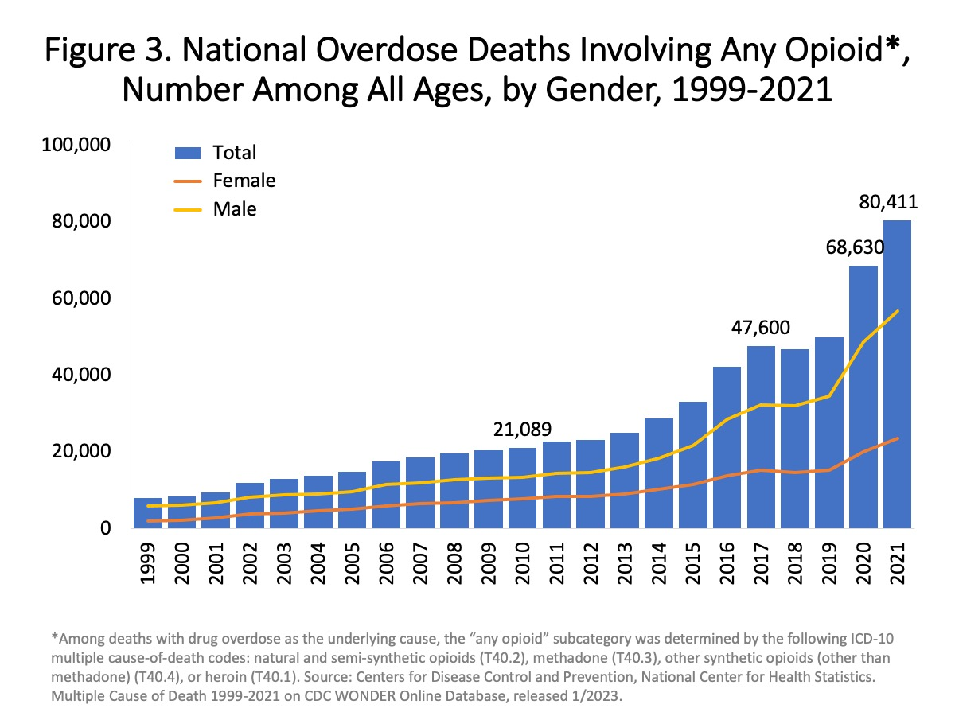
What is Known?
Addiction to Opioids
Opioid Use Disorder (OUD) continues to rise
Fentanyl
Heroin
Hydrocodone
Oxycodone
Morphine
Contingency management
Low success rates
Source: CDC WONDER
Notes:
Contingency management refers to a type of behavioral therapy in which individuals are 'reinforced', or rewarded, for evidence of positive behavioral change. Has low success rate for treating OUD long-term and not all individuals with OUD respond to it.

Slide 20
What Is Known?
How can we effectively treat OUD?
Understand OXT and Orx inputs on stress and reward circuitries
OXT has connections to NAc, VTA, PVN, BLA → ↓F and ↑DA
↓ STRESS & ↑ REWARD SEEKING
Orx has connections to NAc, VTA, PVN, BLA → ↑F and ↑DA
↑ STRESS & ↑ REWARD SEEKING
Notes:
In humans, intranasal oxytocin treatment reduces alcohol withdrawl symptoms, craving, and metabolic brain activity triggered by alcohol-associated cues and it reduces craving scores in patients with heroin and cocaine use disorders.

Slide 21
What Is Known?
OXT treatment
↓ motivation to self-administer opioids and stress-induced alcohol seeking (rats; systemic)
↓ withdrawal symptoms and craving (human; intranasal)
Notes:
OXT treatment
↓ motivation to self-administer methamphetamine, cocaine, and stress-induced alcohol seeking (rats; systemic injection)
↓ withdrawal symptoms and craving (human; intranasal) In humans, intranasal oxytocin treatment reduces alcohol withdrawal symptoms, craving, and metabolic brain activity triggered by alcohol-associated cues and it reduces craving scores in patients with heroin and cocaine use disorders.

Slide 22
What Is Known?
Orx treatment
↓ cue-induced reward seeking (rodents; systemic, Orx₁ antagonist)
↓ drug taking and seeking (DORA, Suvorexant)
Suvorexant approved by FDA in 2014 for treatment of insomnia
Notes:
Orx treatment
↓ cue-induced reward seeking (rodents; systemic, Orx₁ antagonist)
↓ drug taking and seeking (DORA, Suvorexant) Suvorexant approved by FDA in 2014… also used to treat insomnia

Slide 23
What Is NOT Known?
Modulators of reward-seeking behavior
OXT and Orx combination effect?
In what areas of the brain?
Adaptations to molecular components in circuitry
What mechanisms target molecular adaptations?

Slide 24
So, what is the problem?
Role of OXT and Orx system in OUD not fully understood
How can these systems be used to understand OUD?
Molecular mechanisms involved
Effective treatments
↑ in opioid-related fatalities
Need for novel OUD treatment

Slide 25
Why Do We Care?
OUD claims 80,000+ lives in 2021!
Huge increase in deaths every year
Urgent need for novel OUD treatments
Address OXT and Orx influences
Source: CDC WONDER

Slide 26
Why Do We Care?
OXT and Orx may protect against OUD severity
Novel and effective treatment
Understanding OXT and Orx functioning
How do these systems alter molecular mechanisms?
In what areas of the brain?

Slide 27
Hypothesis
Pharmacological modulation of OXT and Orx systems alter reward-related cues to combat addictive behaviors
With cues available or unavailable

Slide 28
Methods
Experimental agents
Synthetic oxytocin
Dual-Orexin Receptor Antagonist (DORA)
Food or heroin self-administration → choice procedures
Cued reward seeking test
Immunohistochemistry and cell counts

Slide 29
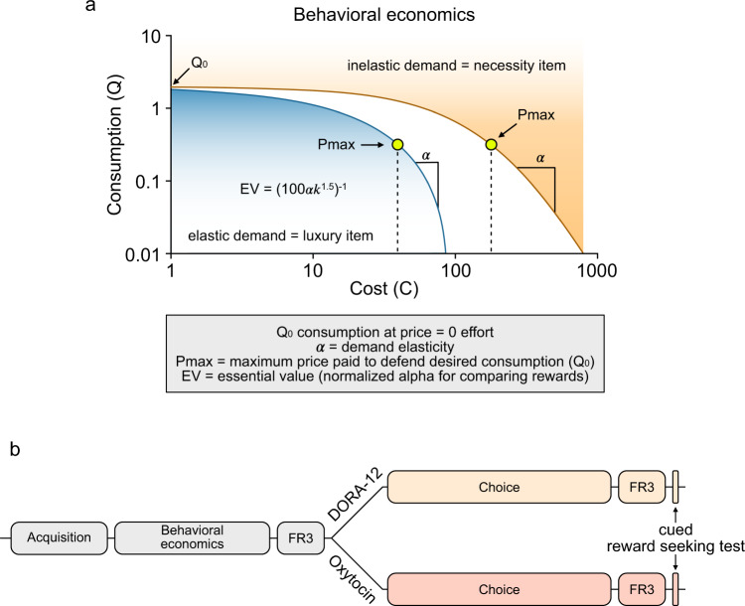
Methods
(Fixed Ratio for Rewards)

Slide 30
Methods
(Fixed Ratio for Rewards)
Notes:
FR= Fixed ratio

Slide 31
Heroin is valued more than food!
Notes:
Demand curves for food and heroin.
More inelastic demand for heroin compared to food in rats

Slide 32
Heroin is valued more than food!
Max price for desired consumption
demand elasticity
Consumption at price
Motivation for heroin exceeds that for food!
Heroin is treated as a necessity and food a luxury!

Slide 33
OXT does not Mediate Opioid Choice

Slide 34
OXT does not Mediate Opioid Choice
OXT antagonist
Notes:
Orx antagonist

Slide 35
Orx does not Mediate Opioid Choice

Slide 36
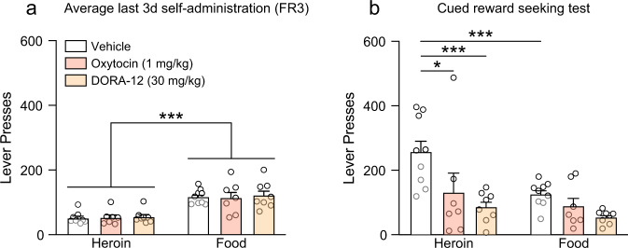
OXT and DORA-12 Reduce Drug Seeking
Treatment with OXT or Orx (DORA-12) reduced responding to heroin, but not food!

Slide 37
Regulation of Reward Pathway
OXT and Orx systems bidirectionally regulate opioid seeking in the presence of competing cues
Activating OXT and Inhibiting Orx (DORA)
→ Normalized reward seeking in the presence of heroin cues to those of food
What does this mean on a molecular level?

Slide 38
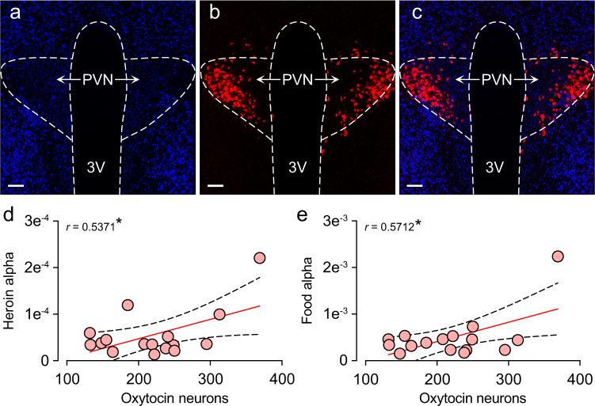
OXT cell numbers associated with heroin and food demand
Notes:
Oxytocin cell counts positively correlate with both heroin and food.

Slide 39
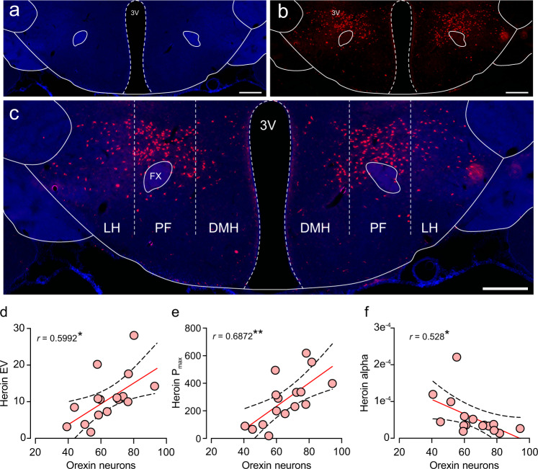
Orx cell numbers associate heroin demand
No correlation between Orx cell counts and food variables
Notes:
Number of LH orexin neurons positively correlated with heroin EV (essential value) and Pmax (max price paid to defend desired consumption) and negatively correlated with heroin alpha (demand elasticity)

Slide 40
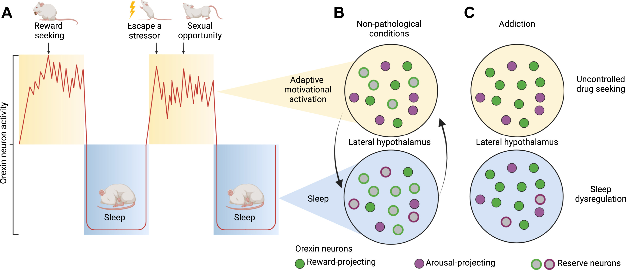
Orx Reserve Pools → adaptive motivation
Notes:
This reserve is normally bidirectionally recruited to permit motivational plasticity that promotes flexible, adaptive behavior.
Increase in orexin cell numbers was causally linked to motivational plasticity for drug. Chronic exposure to drugs of abuse persistently upregulates orexin peptide production in select group of orx neurons, such that the manifestation of addiction is coincident with long-term recruitment of reserve orx neurons due to maladaptive and focused hypermotivation for drug.
Orexin neuron activity (red line) follows a circadian pattern, with peak activity during the active period. Overlaid on this diurnal activity pattern are phasic bursts during waking; these reflect involvement of the orexin neurons in translating motivationally relevant states into adaptive behavior directed toward managing or exploiting a threat or opportunity, a process we referred to as motivational activation.
(B) Motivational activation is also serviced by state-dependent changes in orexin peptide production. Under nonpathological conditions, a reserve population of orexin neurons with projections to key arousal sites is preferentially recruited during the active period to support wake/arousal. Some reserve neurons with projections to reward centers are also recruited to facilitate adaptive motivated behaviors (e.g., feeding). Recruitment of these reserve cells is primarily governed by circadian factors. Note that nonreserve neurons may also increase their peptide production as a function of behavioral state (not shown here). (C) Addiction to drugs is characterized by a persistent and preferential recruitment of orexin reserve neurons that project to reward regions, resulting in sustained, hypermotivated, and uncontrolled drug seeking behavior. A loss of plasticity in peptide production by the reserve population also contributes to inappropriate arousal during the inactive period, resulting in sleep dysregulation in addiction. [Figure adapted from (7)].

Slide 41
Take Home Messages
OXT and Orx bidirectionally regulate reward-seeking
Affect behavioral outcomes
Opioid cues to bias choice while in withdrawal stages
Normalization of Orx levels ↓ drug motivation
Orx reserve pool → adaptive motivational behaviors
↑ Orx peptide production & neuron activity
Notes:
Activating OXT and inhibiting Orx bidirectionally regulates reward seeking;
Opioid cues to bias choice while in withdrawal stages.
Normalization of orexin levels also reduce drug motivation in addicted models

Slide 42
Thoughts to Consider
Specific neural circuitry impacts with OXT and Orx treatments
Modulation of other areas in OXT and Orx circuitry
BLA
Hippocampus
Future studies: what’s next?
How does OXT and Orx treatment impact relapse behavior?
Signaling components involved? Receptor numbers?
Notes:
Animals with high baseline motivation are most susceptible to the ability of (said drug, like Suvorexant or SB-334867) to decrease addiction behaviors.

Slide 43
Conclusion
Both OXT and Orx have similarities brain areas and signaling
Neurons in the PVN, Amygdala, Hippocampus, etc.
Dysfunction of PLCβ1 isoform = stress and addiction
OXT and Orx treatment can regulate the reward circuitry
Adjust addiction behaviors
Prevent OUD fatalities
Orx reserve pool increases adaptive motivational behaviors
Notes:
Both OXT and Orx have similarities brain areas and signaling
Neurons in the PVN, Amygdala, Hippocampus, etc.
dysfunction of PLCβ1 isoform = stress and addiction
OXT and Orx treatment can regulate the reward circuitry
Adjust addiction behaviors
Prevent OUD fatalities

Slide 44
Thank you!
Questions? Let’s have a chat!

