Slide 1
Endocannabinoids and…. Endocannabinoids and… Anxiety
James M. Robertson

Slide 2
Lab Facts
Serving Size 2mg/ml THC; 8mg/ml CBD
Cannabinoids 175.2/bottle
THC 0.15 mg/ml
CBD 9.63 mg/ml
Serving Suggestions
Under 100 lbs. 1/2 Dropper
100-150 lbs. 1 Dropper
150-200 lbs. 1 1/2 Droppers
200-250 lbs. 2 Droppers
Alta Botanicals Anxiety Relief Internal Tincture
$40
15ml Bottle
“Relieve your daily anxieties with this tasty, easy to use cannabis anxiety relief tincture. With its high CBD and low THC quantities, this is perfect to use anytime, anywhere.”
“This flavorful, high CBD anxiety relief tincture offers the maximum healing properties of CBD with mild psychoactivity. Its properties have been shown to relieve anxiety, PTSD and acute pain resulting from inflammation.”
“It is known for being immunosuppressive, an appetite suppressant, a vasorelaxant and effective for certain neuromuscular disorders. Anxiety Relief tincture can be used to neutralize the effects of THC.”

Slide 3
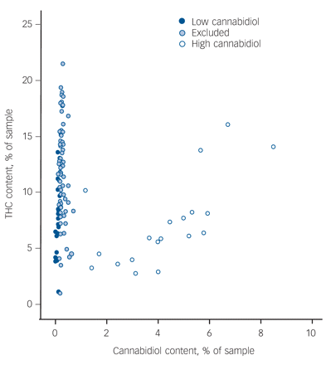
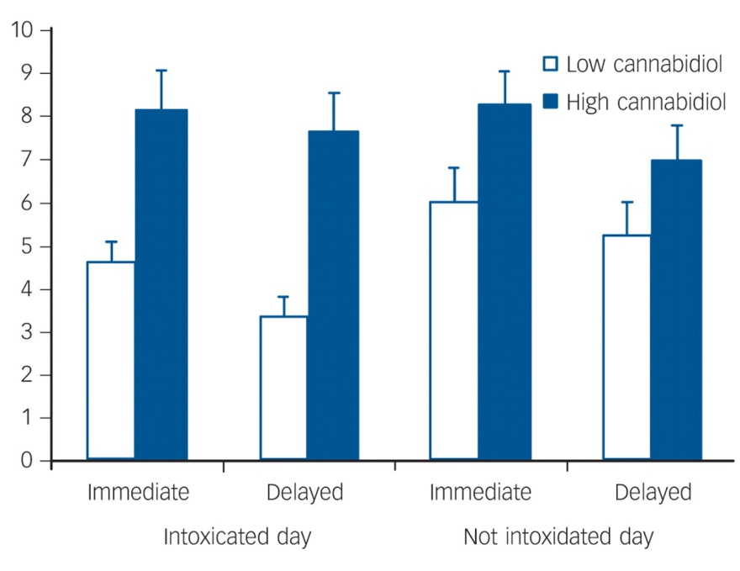
CBD and THC
Opposing effects
CBD may reverse psychotomimetic effects of THC
Reverse impact on memory
CBD
Reduced Social Isolation induced by THC (rats)
Anti-depressant effects in animal models
Reduced anxiety

Slide 4
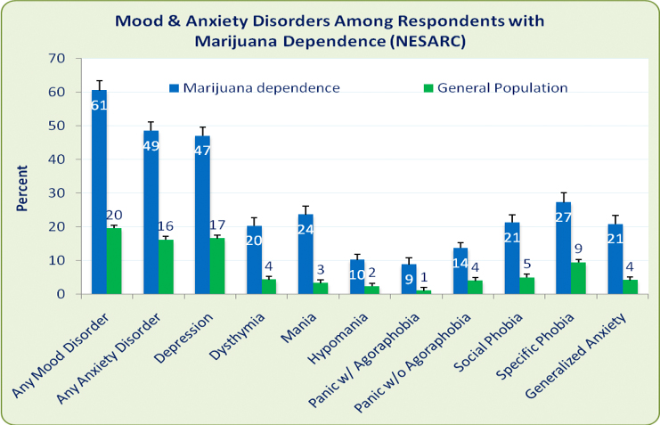
Reefer Madness

Slide 5
Hill and Patel
eCB synthesis/receptors in limbic system
PFC, Amygdala, Hippocampus, Nucleus Accumbens
“eCBs are ideally situated to modulate synaptic integration and efficacy within limbic neurocircuitry”
“Thus exerting profound effects on emotional behaviors”

Slide 6
Hill and Patel
eCB signaling constrains anxiety
Verified in animal models
eCB anxiety response modulated at various levels of AEA synthesis
FAAH inhibition
Role in depression not as clear
Some conflicting data
Short Term/Long Term CB1 inhibition depends on location
Repeated Stress
AEA and 2-AG may have “tonic” and “phasic” effects, respectively

Slide 7
Rea et al. – eCBs and FCA
Fear Conditioned Analgesia (FCA)
Powerful suppression of nociceptive behavior during or after expression of Pavlovian Conditioned Fear
Thought to involve GABAergic, opiodergic signaling
CB1 receptors expressed on Glu, GABA neurons in areas associated with FCA
eCBs synthesized On Demand = UC Stress-Induced Analgesia

Slide 8
Rea et al. - Methods
Amygdalar eCBs mediate FCA
Microinjections into BLA, CeA
Group 1:
Microinjections:
Bicuculline - GABA_{A} antagonist
MPEP – mGluR5 antagonist
Intraperitoneal:
AM251 – CB1 receptor antagonist
Group 2:
Microinjections:
AM251
Group 3: No cannulae, microinjections, IP, etc…

Slide 9
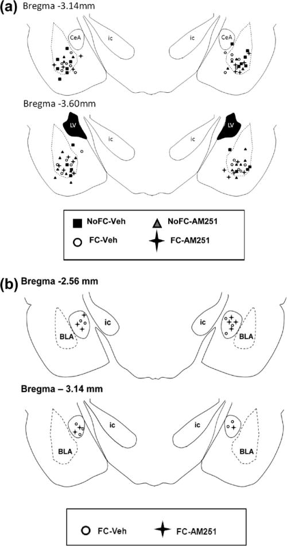
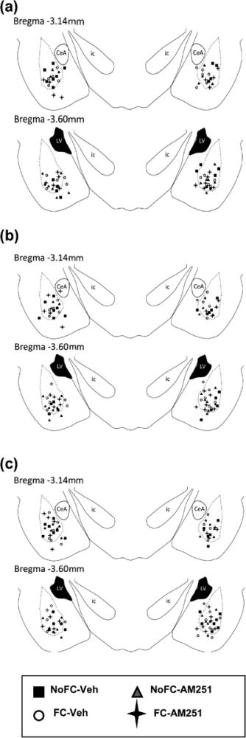

Slide 10
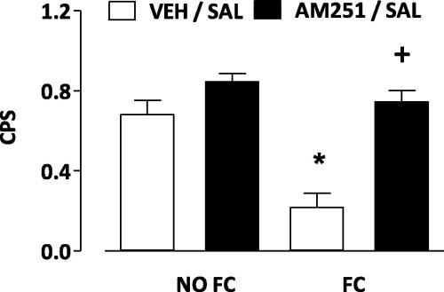
CB1 antagonism attenuates FCA
Systemic ➔
⬅ Intra-BLA

Slide 11
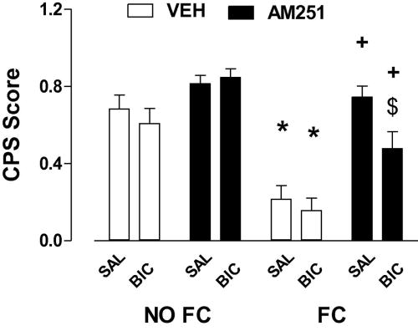
GABA_{A} antagonism partially restores FCA

Slide 12
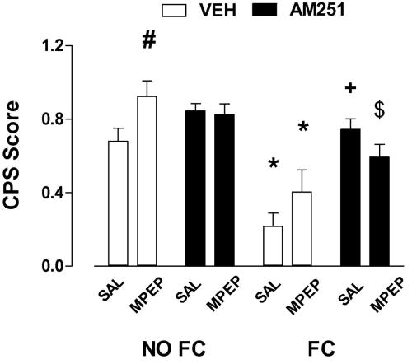
mGLUR5 antagonism partially restores FCA

Slide 13
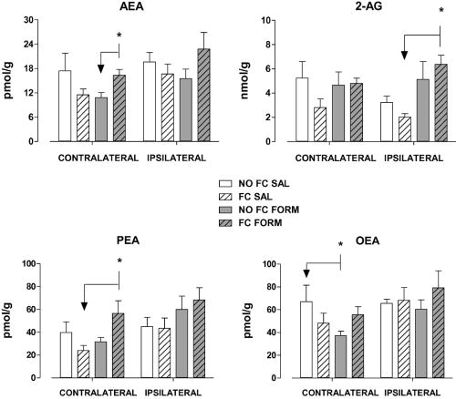
FCA associated with increased eCB levels in tissue

Slide 14
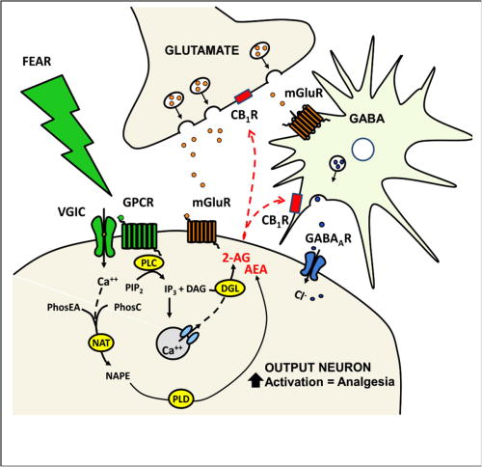
Rea et al. - Take Homes
eCB in BLA mediates FCA
Fear Conditioning may prime eCB response in BLA
GABA/Glu transmission plays a role
CB1 activation on Glu, GABA neurons reduce GABA output, disinhibit output neurons, activate “inhibitory pain pathway”

Slide 15
Video Breakdown!

Slide 16
Qin et al. - Methods
Intracellular cascades could affect mGluR5 signaling ➔ affect anxiety and fear through eCBs
LM04 reduction inhibits downstream signaling capacity of mGluR5 via PTP1B
LM04 deficient mice = PROFOUND ANXIETY
Stress ‘em and Test ‘em

Slide 17
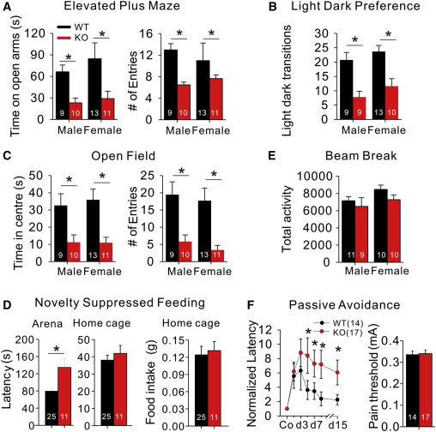
LM04KO mice are super stressed out

Slide 18
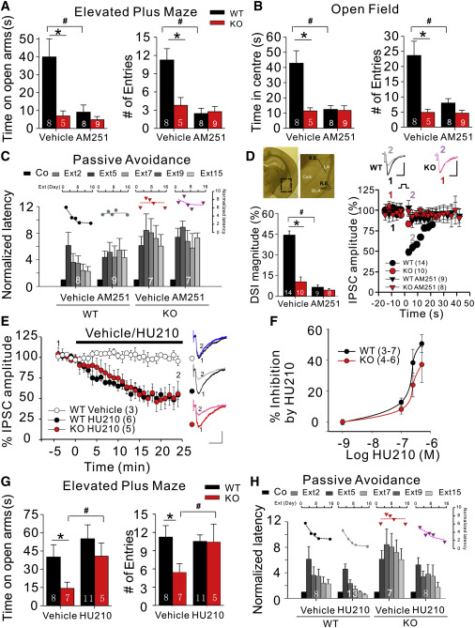
CB1 antagonism in WT mice makes them similar to LM04KOs

Slide 19
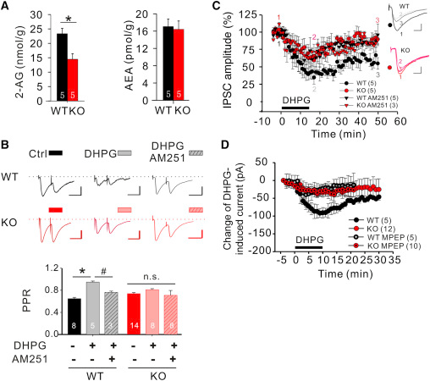
mGluR dependent eCB mobilization impaired in LM04KO amygdala

Slide 20
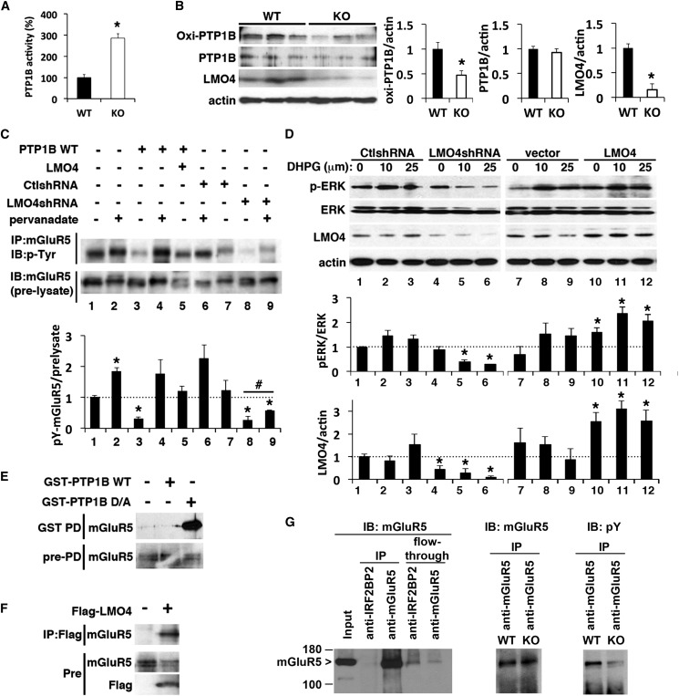
It works the way they say it works

Slide 21
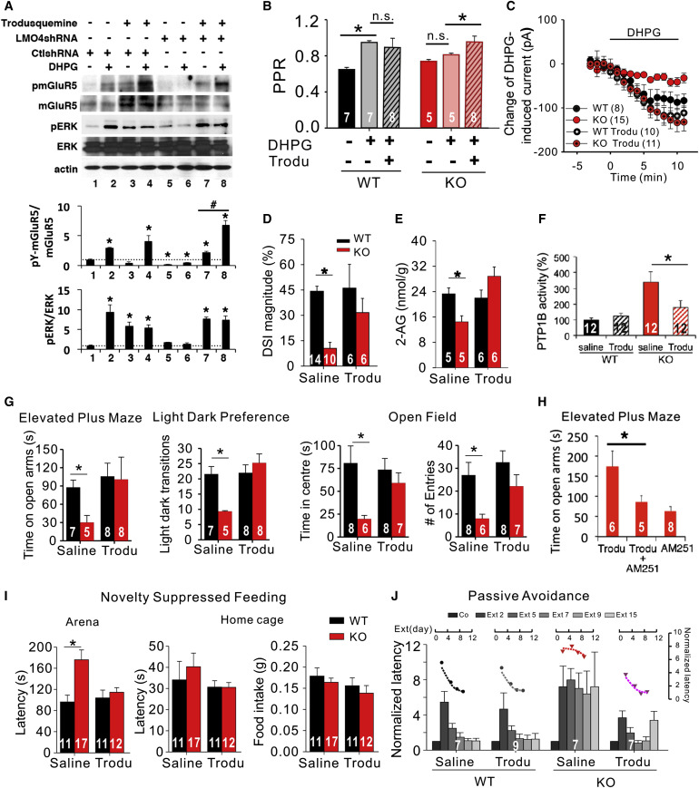
“Look, we can reverse it, too!”
Trodusquemine
PTP1B inhibitor
Restores mGluR function

Slide 22
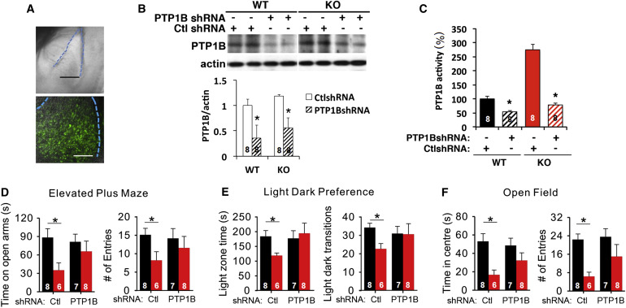
Genetic modification verifies results

Slide 23
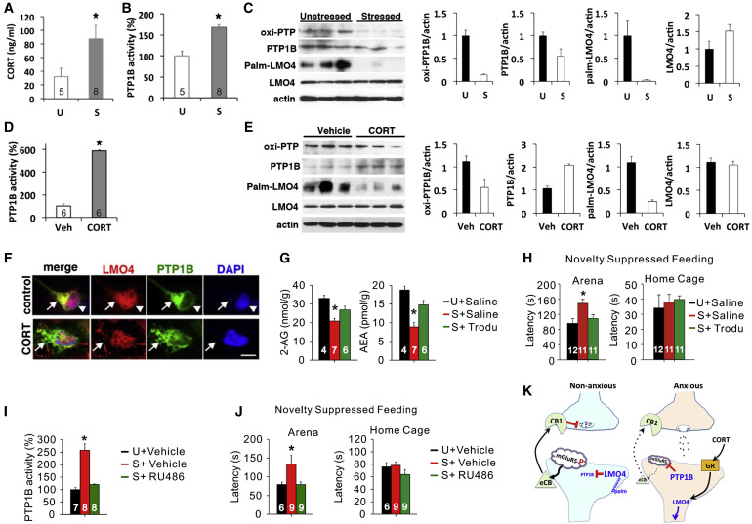
Corticosterone drives the process in repeatedly stressed individuals

Slide 24
Qin et al. – Take Homes
Novel signaling cascade in the amygdala for controlling anxious behavior
LM04 constrains PTP1B
Reduced LM04 ➔ Increased PTP1B ➔ mGluR5 dephosphorylation ➔ impaired mGluR5 signaling ➔ suppressed eCB signaling (2-AG)
eCBs modulate stress via complex chemical cascades with many precursor stages
Can be modulated, in turn, by other factors, like prolonged stress (glucocorticoid release)

