Slide 1
Endocannabinoid & Stress system interactions
Raj Solanki

Slide 2
General model illustrating endocannabinoid signaling

Slide 3
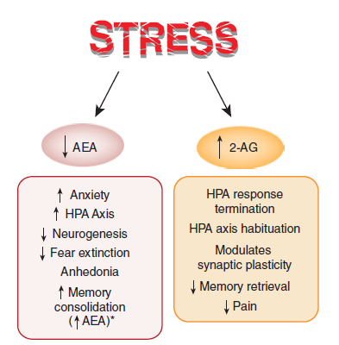
Interactions between stress and endocannabinoid system

Slide 4
Lee et al., 2015: disruption of peri-adolescent eCB signaling modulates adult neuroendocrine and behavioral responses in male rats Experimental timeline:
PND 30
PND 70
10 days

Slide 5
Stress coping behavior following peri-adolescent CB1R antagonism (Forced swim test)

Slide 6
Risk assessment behavior following peri-adolescent CB1R antagonism (on EPM test)

Slide 7
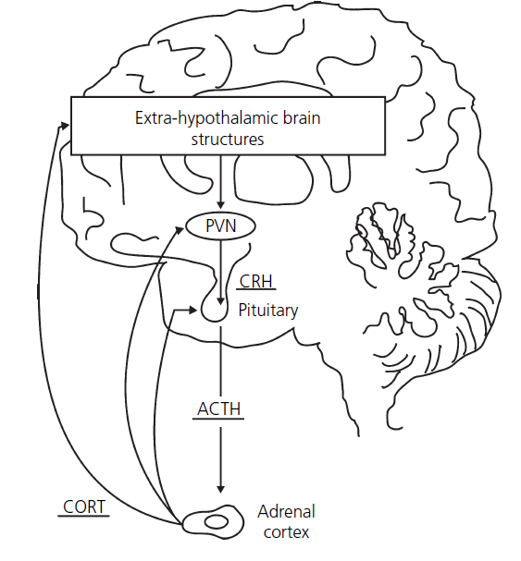
Effects of eCBS on HPA axis
CB1 receptors are localised in the PVN of the hypothalamus as well as in limbic structures involved in the regulation of the stress response
Moreover, CB1 are present in the human pituitary, particularly in corticotroph cells and in the adrenal glands
Depending on dose and mechanism of action (agonist/antagonist), eCBs increase or decrease HPA axis function

Slide 8
Effect of peri-adolescent CB1R antagonism on HPA axis (plasma ACTH levels)

Slide 9
Effect of peri-adolescent CB1R antagonism on HPA axis (plasma corticosterone levels)

Slide 10
Effect of peri-adolescent CB1R antagonism on eCB system content (AEA & 2-AG)

Slide 11
Take home message:

Slide 12
Adult CB1R expression & binding affinity following peri-adolescent CB1R antagonism
 | Bmax (pmol/mg protein) |  | KD (nM)
 | VEH | AM-251 | VEH | AM-251
Amygdala | 0.68 + 0.13 | 0.63 + 0.06 | 0.54 + 0.09 | 0.64 + 0.07
Hippocampus | 1.04 + 0.06 | 1.12 + 0.07 | 0.89 + 0.05 | 1.03 + 0.06
Hypothalamus | 0.24 + 0.03 | 0.19 + 0.02 | 0.44 + 0.05 | 0.44 + 0.04
Prefrontal Cortex | 0.81 + 0.05 | 1.00 + 0.05* | 0.71 + 0.08 | 0.84 + 0.07

Slide 13
Bluett et al., 2014: Central AEA augmentation reverses anxiety like behavior
Behavioral testing timeline:
Foot shock stress
22 hr
Drug administration
2 hr
Behavioral
testing
FAAH-Inhibitor: PF 3845/ CB1R antagonist:
Rimonabant
Light-dark box/ Novelty induced hypophagia

Slide 14
Continue…..
Novelty induced hypophagia:
Hypophagia: reduction in food intake and eating behavior
Training days: 1-4 days
Carried out in home cage
Procedure: each day 30 min red light
Habituation, followed by replacement of water with highly palatable
Substance “Ensure” (liquid vanilla)
Parameters: Latency to first consumption & total consumption
Foot
Shock
Test day: 1 day
Procedure: 60 min red light habituation
In home cage
Novelty test: mice transferred to the new cage in a brightly lit room with 30 min access to “ensure”
Parameters: latency & total consumption
24 hr

Slide 15
FAAH-inhibitor reduces anxiety like behaviors; the effect reversed by CB1R antagonism

Slide 16
Stress reduces whole brain AEA level while FAAH inhibitor increases it

Slide 17
Whole brain AEA reduction correlates with increase anxiety in light-dark box test

Slide 18
Take home message:

Slide 19
THANK YOU

