Slide 1
Pain, Stress and Endocannabinoids

Slide 2
Endocannabinoid(eCB)
eCBs are lipid neurotransmitters, synthesized on demand
eCBs act on both cannabioid receptors (CB1 and CB2) and Transient Receptor Potential Vanilloid (TRPV) channels
Depress Glutamatergic and GABAergic synapses
2-AG and Anandeminde (AEA)

Slide 3
2-AG and AEA metabolism
DAGL
MAGL
diacylglycerol
2-AG
arachidonic acid
NAPE-PLD
FAAH
NAPE
AEA
arachidonic acid

Slide 4
Pain-Nociception
Nociception: detection of noxious stimuli
Noxious stimuli: elicit tissue damage and activate nociceptors
Nociceptors: detect signals from damaged tissue
    Thermal- activated by extreme temperatures
    Mechanical- activated by intensive pressure to skin (primarily conducted by myelinated Aδ fibers)
    Chemical- activated by chemical substances
    Polymodal- activated by thermal, mechanical and chemical (conducted by the unmyelinated C fibers)

Slide 5
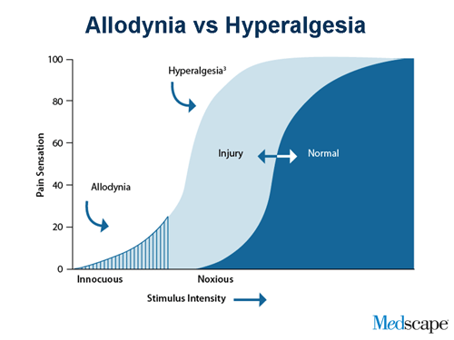
Allodynia :pain due to a stimulus that does not usually provoke pain
hyperalgesia :increased pain from a stimulus that usually provokes pain

Slide 6
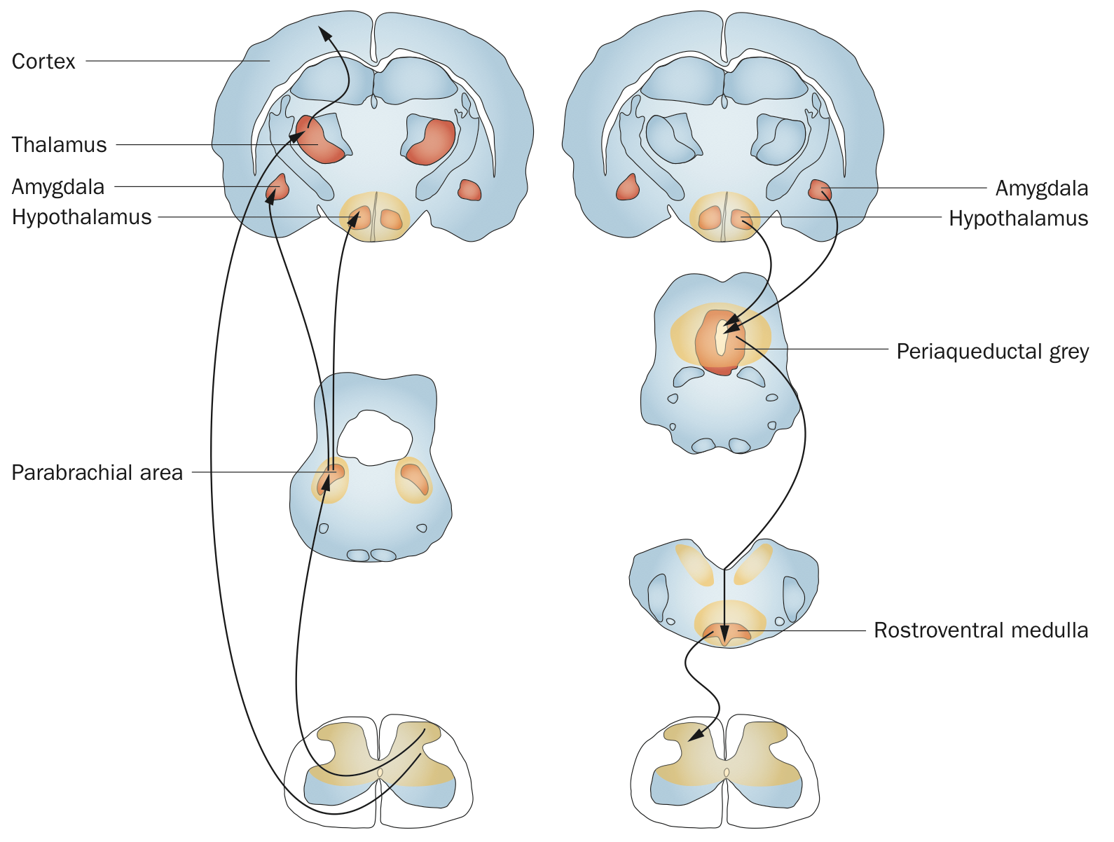
Ascending pathway
Descending pathway
Bradl et.al 2014

Slide 7
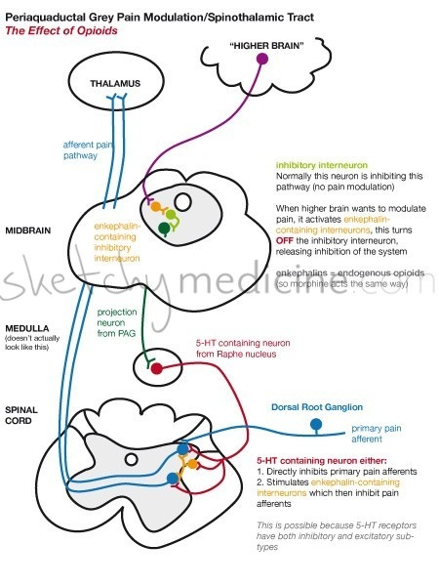
The periaquaductal grey (PAG) pathway is the descending pathway that helps modulate pain.
There are so many double/triple/quadruple negatives in this pathway it makes the head spin.
Who knew that the activation of the inhibitory interneuron would inhibit the other inhibitory interneuron, releasing inhibition of another neuron only to inhibit pain?

Slide 8
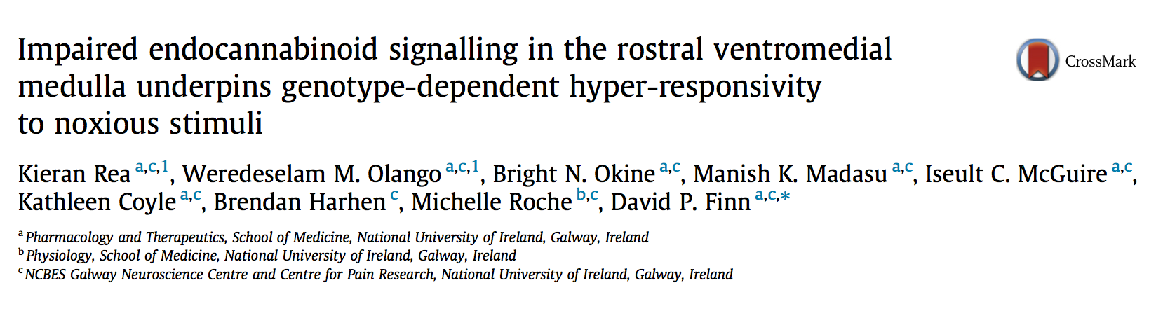

Slide 9
Summary
Stress-hyperresponsive phenotype exhibited formalin-induced hyperalgesia
    due to lower level of AEA and 2-AG in RVM
Stress-induced hyperalgesia was relieved by AEA
Stress-induced hyperalgesia was potentiated by CB1 receptor antagonist

Slide 10
Experiment I

Slide 11
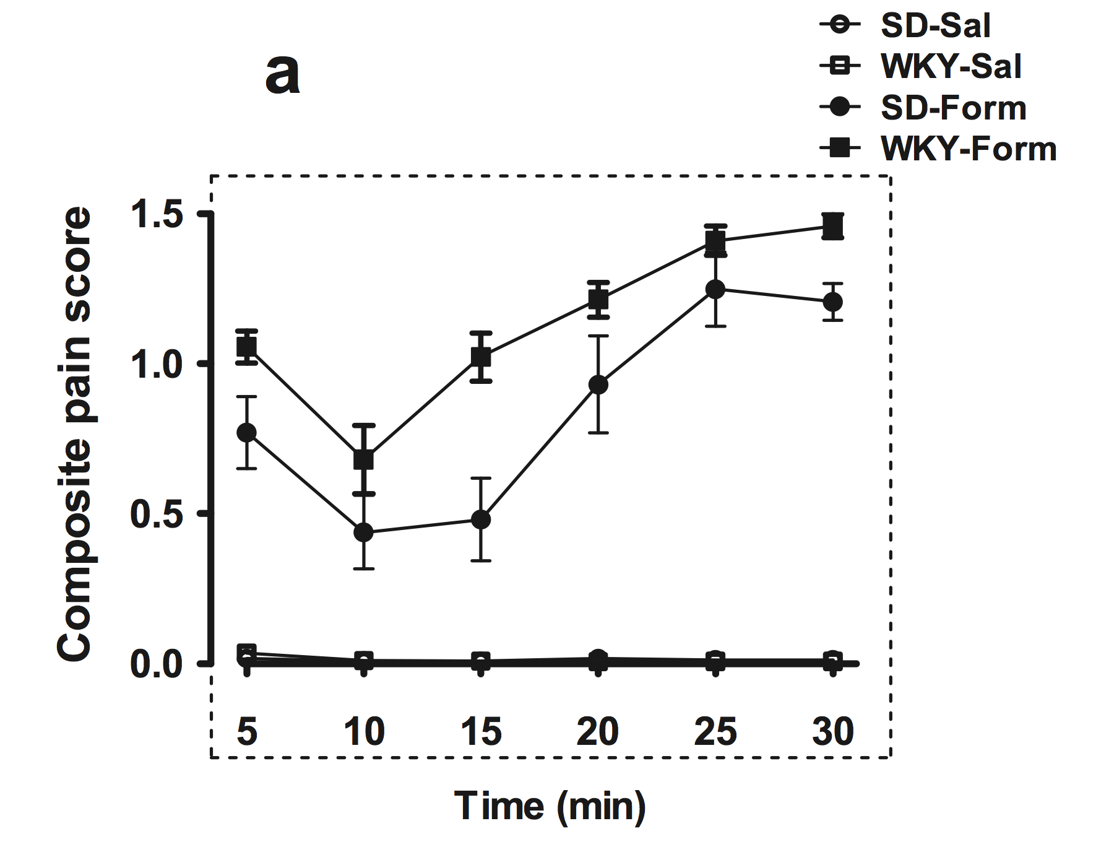
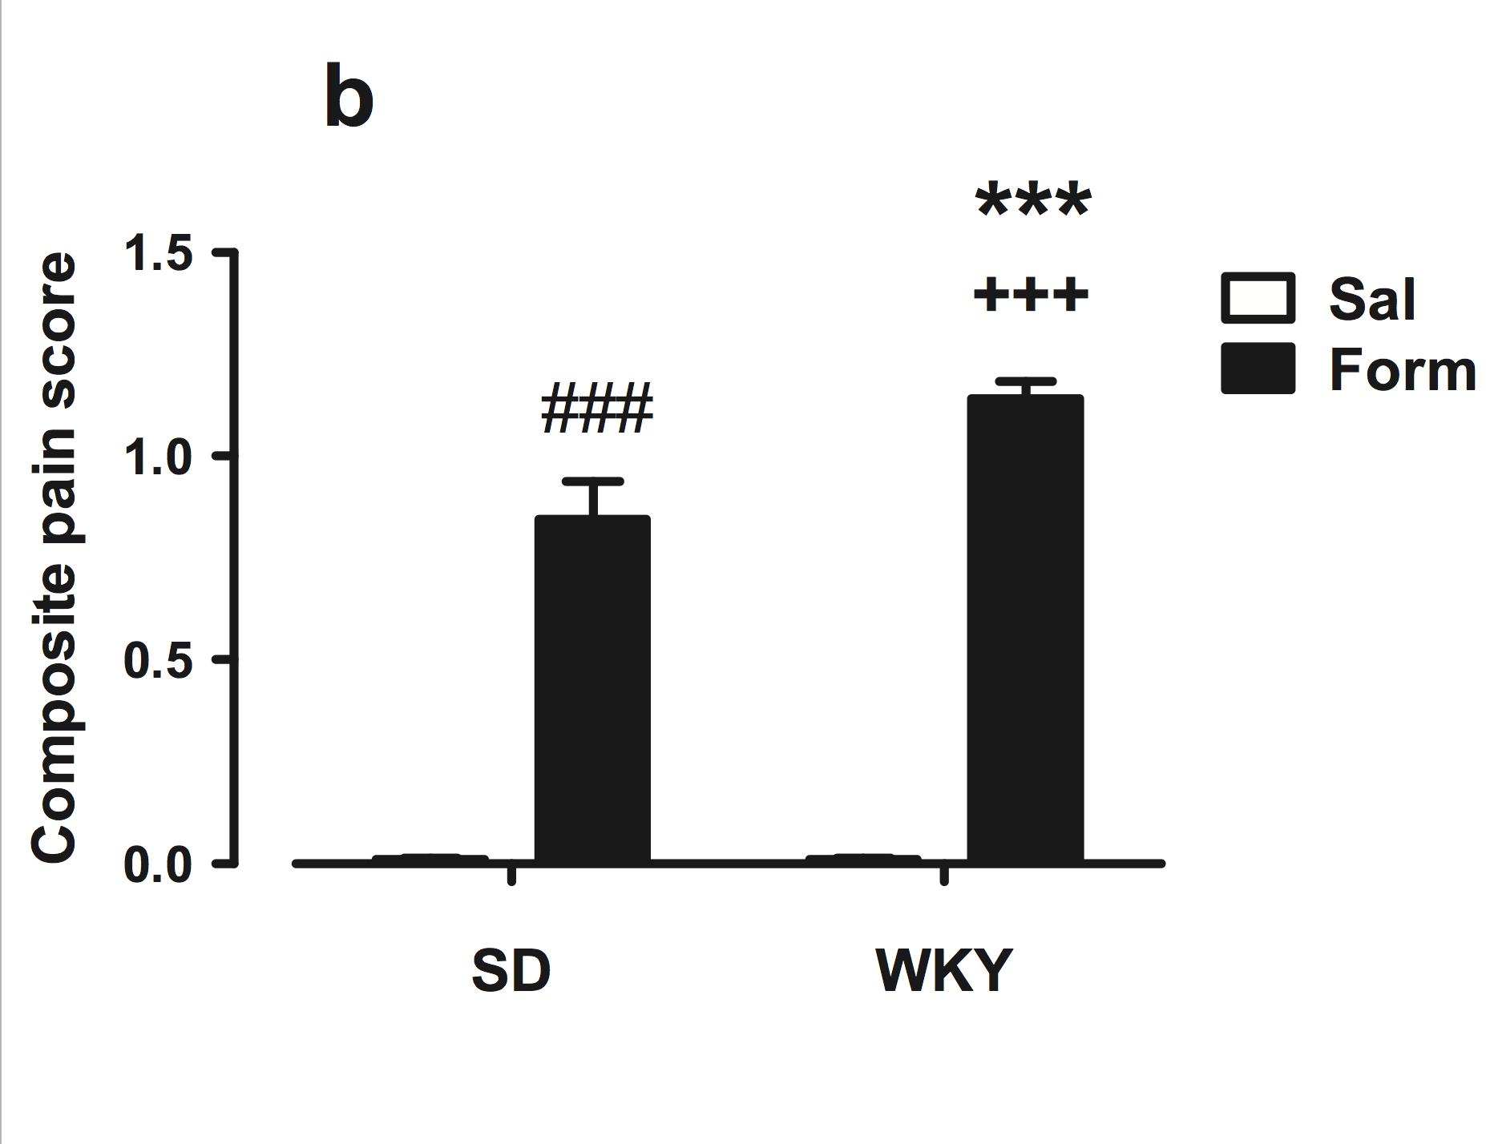
I. Injection of formalin increases nociceptive behavior
1a
each time point
1b
over entire 30 min trial
depressed phenotype with formalin
formalin
formalin
normal phenotype with formalin
feel more painful
feel more painful
no
formalin
no
formalin
normal phenotype
depressed phenotype

Slide 12
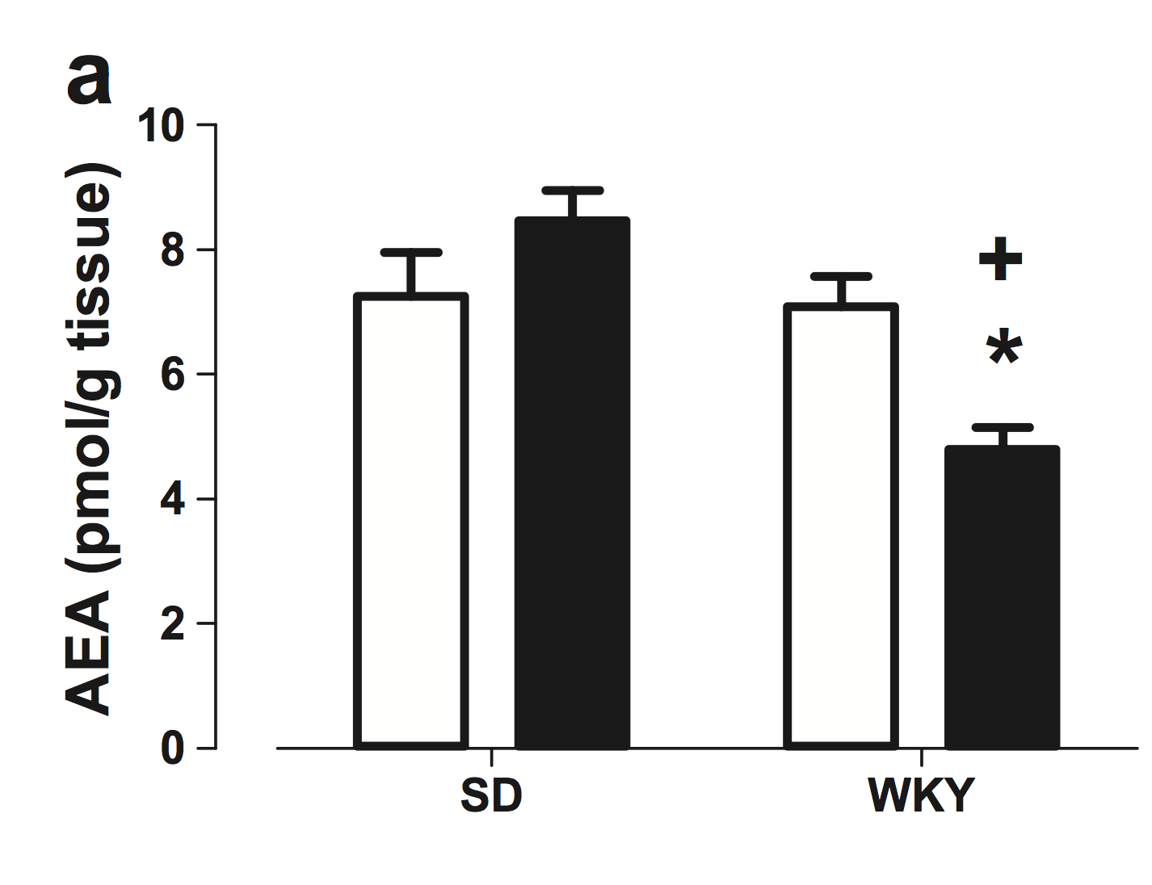
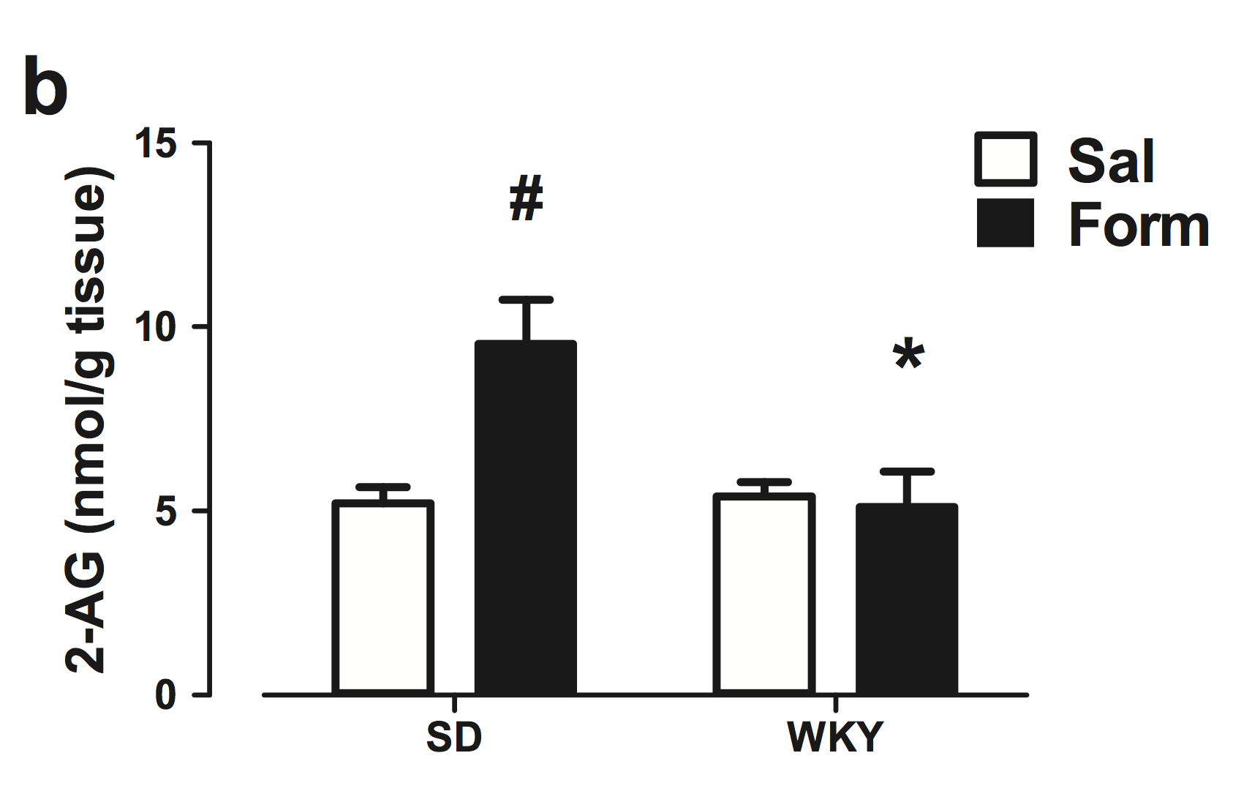
I. AEA level is decreased in depressed phenotype with formalin
2-AG level is increased in normal phenotype with formalin
2a
AEA level in RVM
2b
2-AG level in RVM
increased AEA level
increased 2-AG level
normal phenotype
depressed phenotype
normal phenotype
depressed phenotype

Slide 13
2-AG and AEA metabolism
DAGL
MAGL
diacylglycerol
2-AG
arachidonic acid
NAPE-PLD
FAAH
NAPE
AEA
arachidonic acid

Slide 14
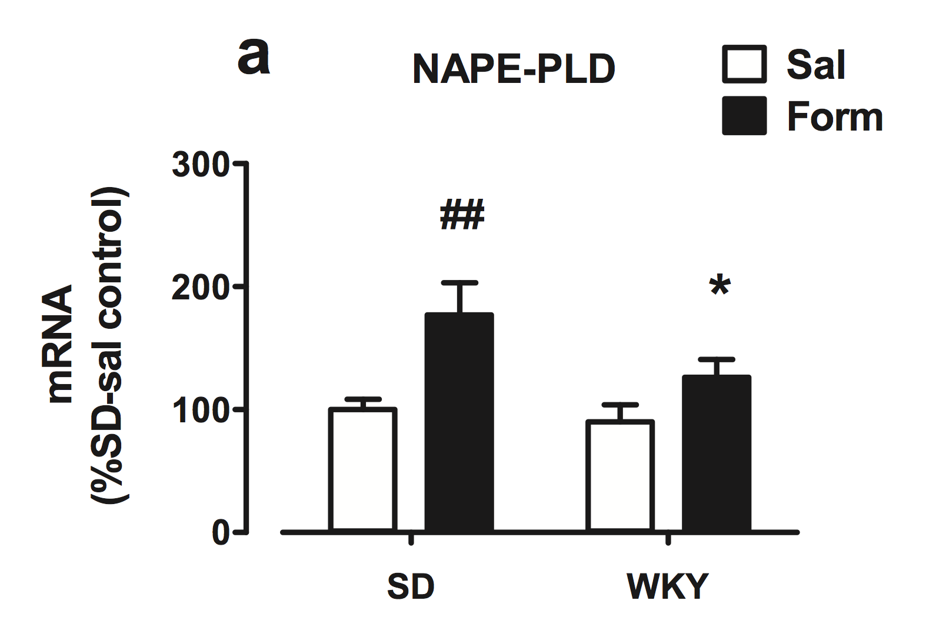
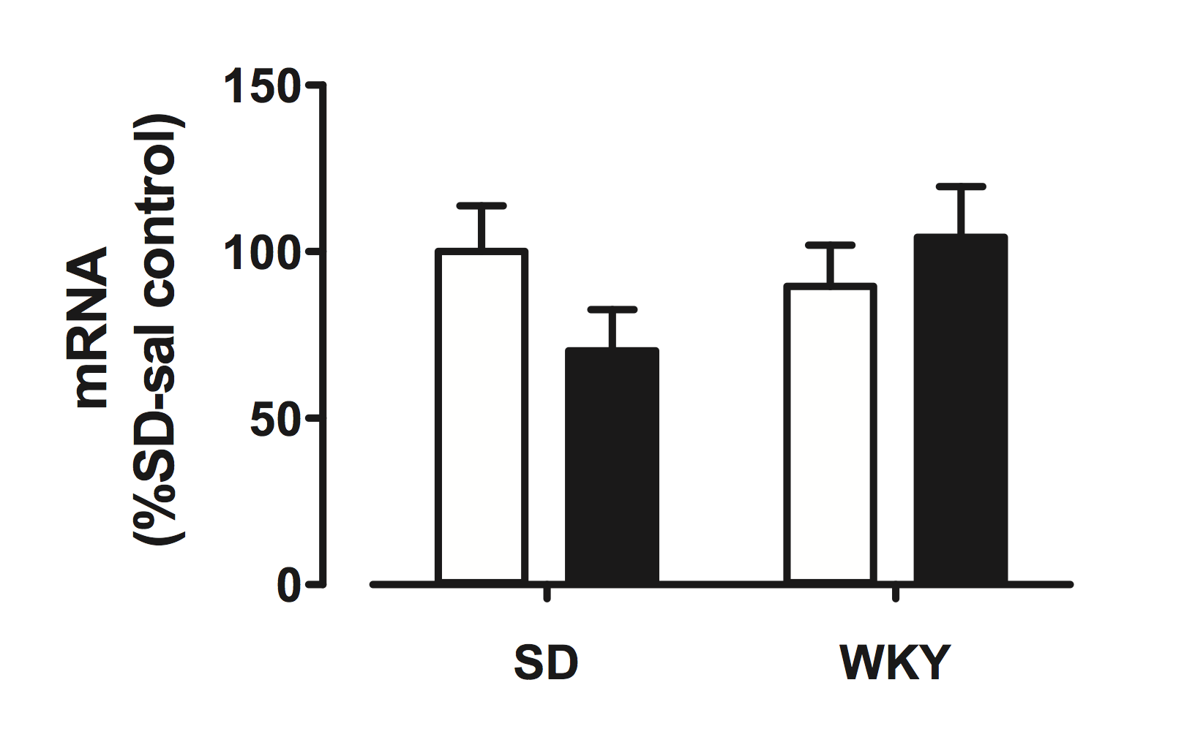
I. mRNA coding for NAPE-PLD is increased in normal phenotype with formalin
2-AG level is increased in normal phenotype with formalin
3a
NAPE-PLD mRNA level
3d
FAAH mRNA level
more AEA
less AEA
normal phenotype
depressed phenotype
normal phenotype
depressed phenotype
Notes:
add figure about sea metabolism

Slide 15
I. mRNA coding for NAPE-PLD is increased in normal phenotype with formalin
2-AG level is increased in normal phenotype with formalin
3a
NAPE-PLD mRNA level
3d
FAAH mRNA level
more AEA
more AEA
normal phenotype
depressed phenotype
normal phenotype
depressed phenotype
Notes:
add figure about sea metabolism

Slide 16
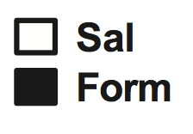
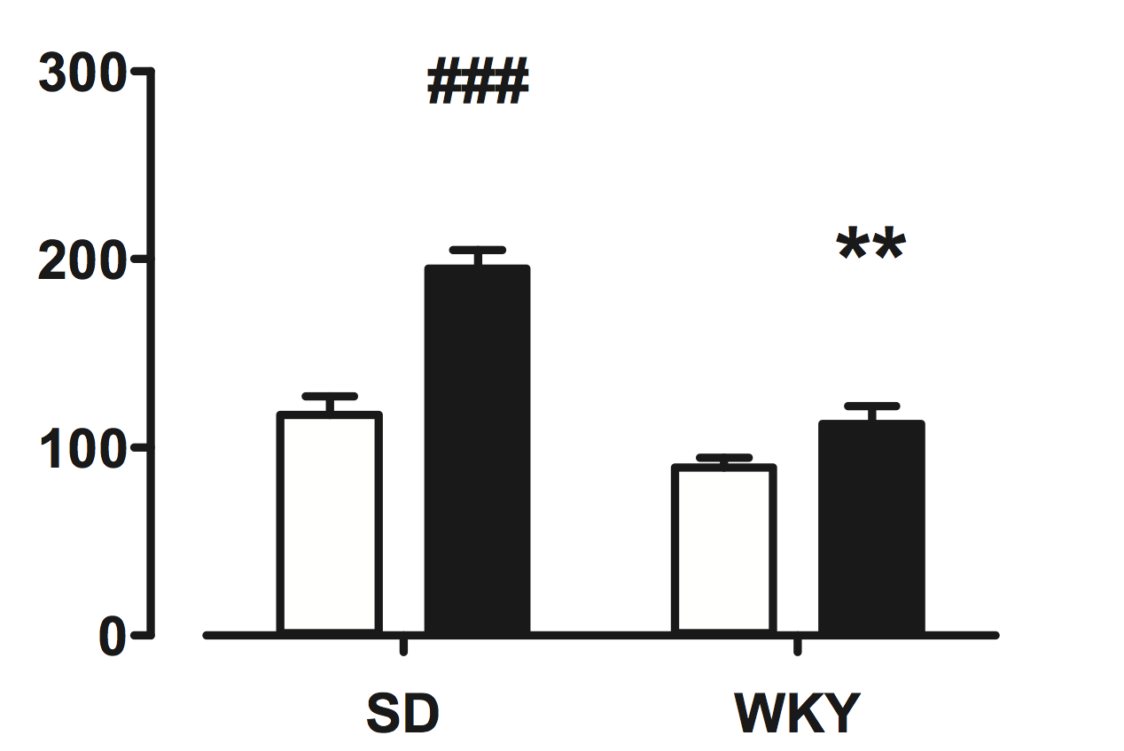
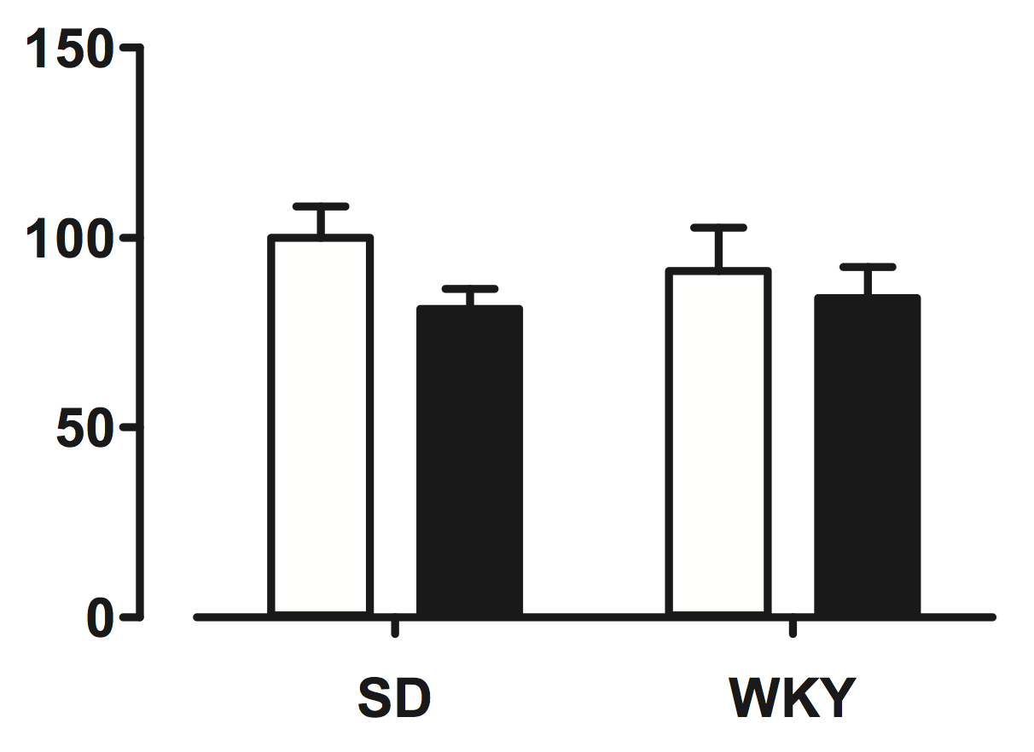
I. mRNA coding for DAGL∂ is increased in normal phenotype with formalin
2-AG level is increased in normal phenotype with formalin
3b
DAGL∂ mRNA level
3c
MAGL mRNA level
more 2-AG
more 2-AG
normal phenotype
depressed phenotype
normal phenotype
depressed phenotype
Notes:
add figure about sea metabolism

Slide 17
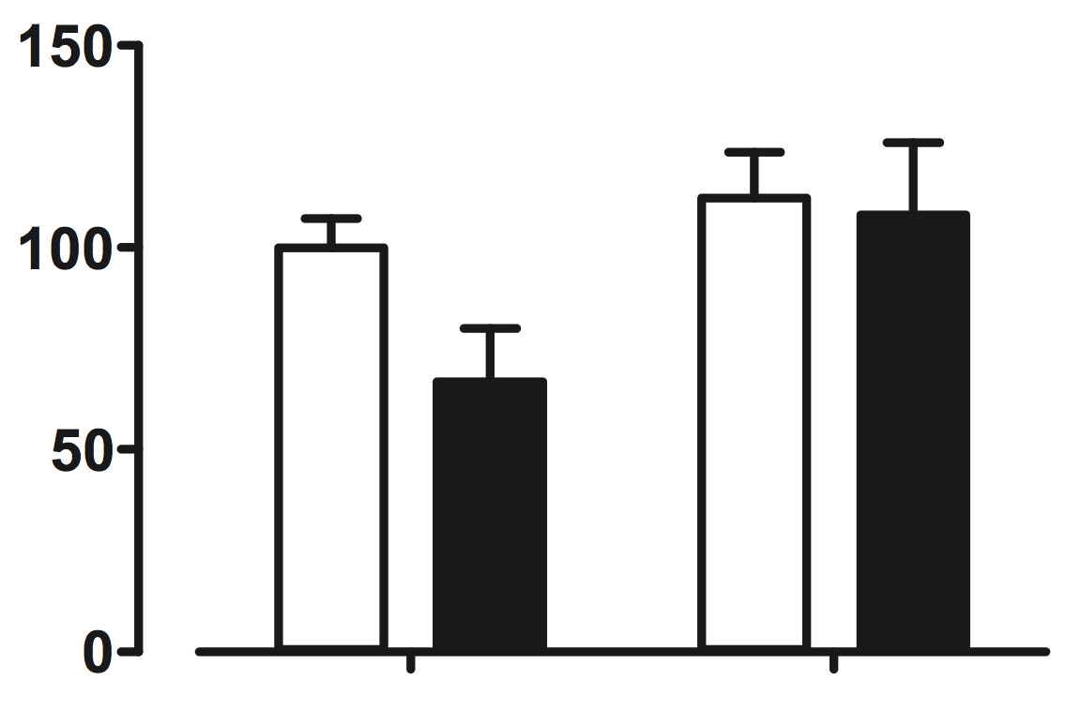
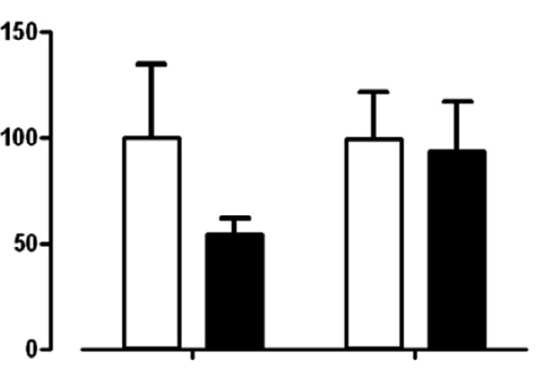
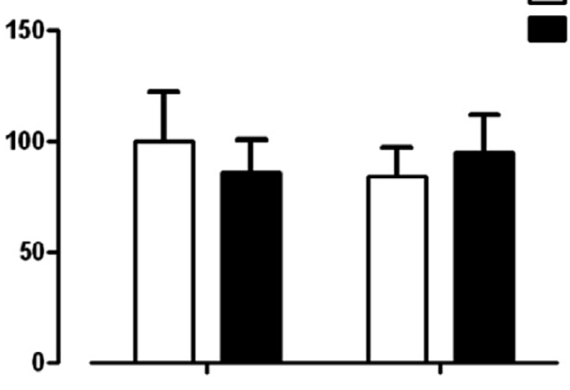
I. No changes of CB1 receptor expression in either group
3e
CB1 mRNA level
4a
Glycosylated CB1
protein level
4b
Non-glycosylated CB1
protein level
CB1 receptor expression
normal phenotype
depressed phenotype
normal phenotype
depressed phenotype
normal phenotype
depressed phenotype

Slide 18
Experiment II

Slide 19
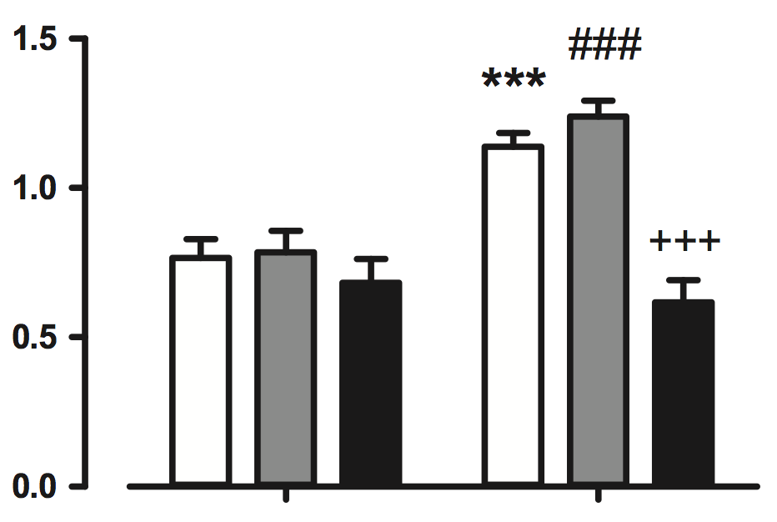
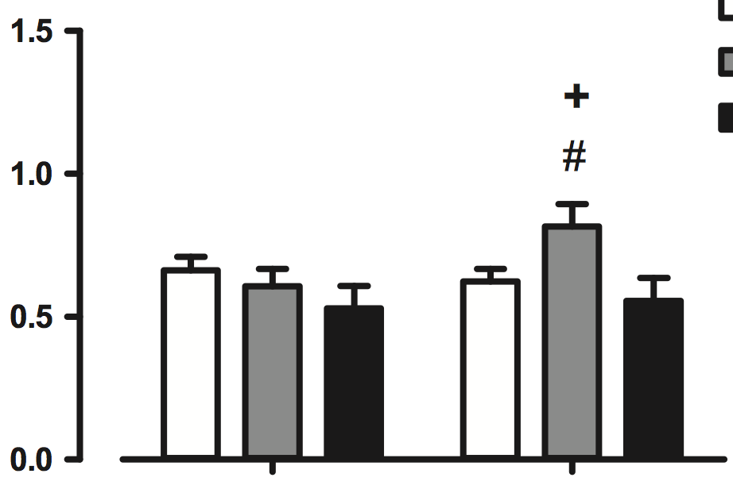
II. Blockade of CB1 potentiates formalin-induced pain behavior
Increasing AEA decreases formalin-induced pain behavior
5c
0~40 min
CB1
5d
35~70 min
CB1
√
√
AEA
AEA
√
√
AEA
CB1
AEA
CB1
feel more painful
feel more painful
normal phenotype
depressed phenotype
normal phenotype
depressed phenotype

Slide 20
Experiment III

Slide 21
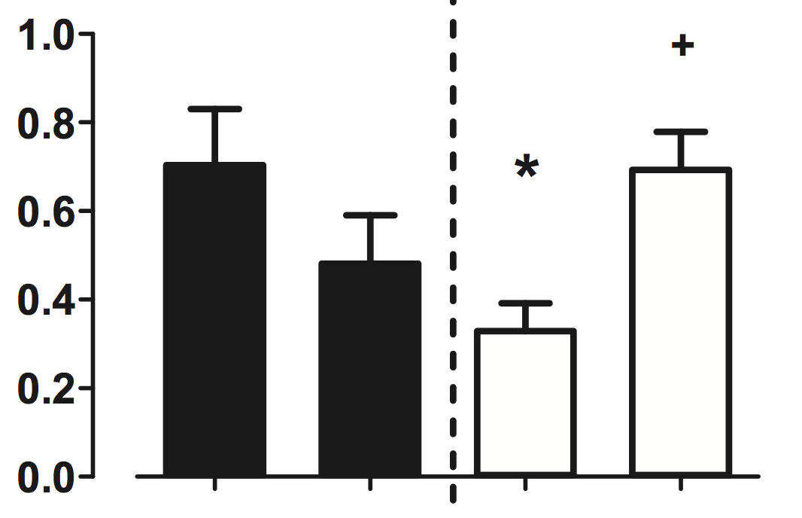
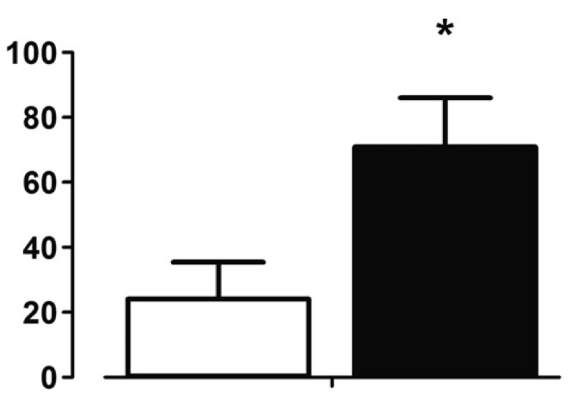
III. Formalin-induced pain behavior in depressed phenotype is AEA/CB1-dependent
RVM
CB1
7
6b
intraperitoneal (i.p.) injection of FAAH inhibitor=>stop AEA degradation
i.p.
AEA
RVM
DMSO
i.p.
AEA
√
√
RVM
CB1
control
more AEA
feel more painful
depressed phenotype
depressed phenotype

Slide 22
Summary
Stress-hyperresponsive phenotype exhibited formalin-induced hyperalgesia
    due to lower level of AEA and 2-AG in RVM
Stress-induced hyperalgesia was relieved by AEA
Stress-induced hyperalgesia was potentiated by CB1 receptor antagonist

Slide 23
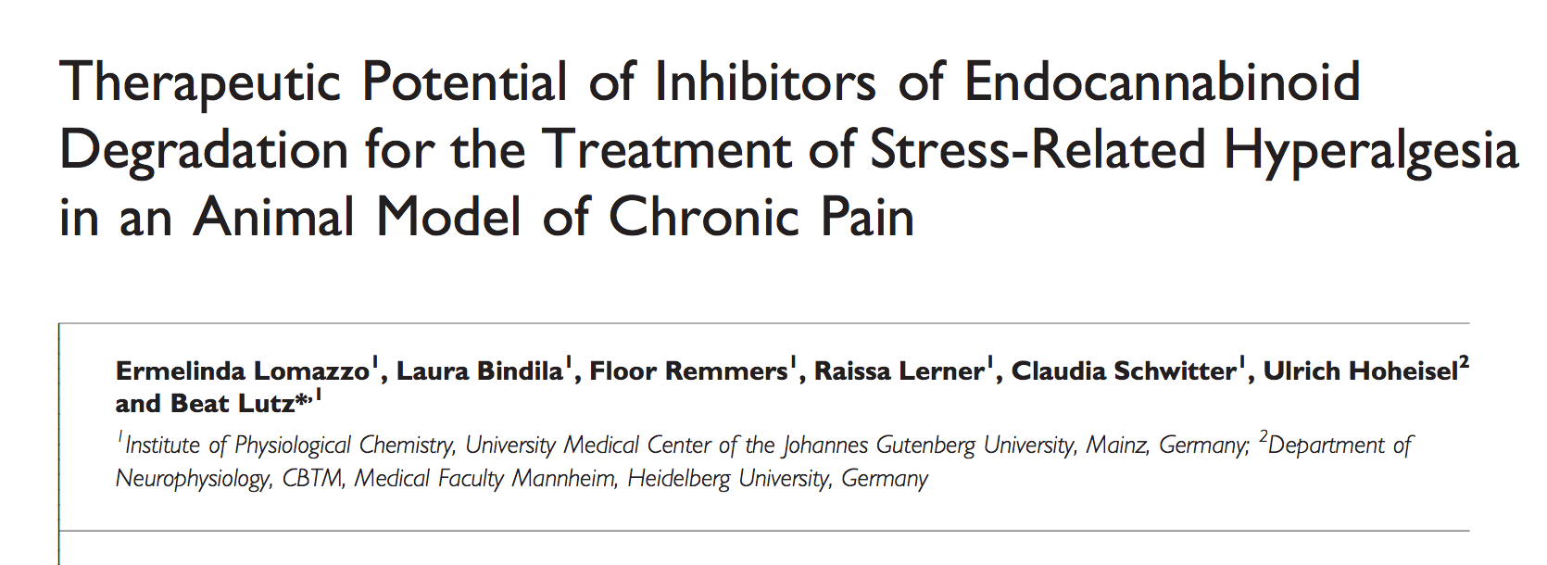
Notes:
animal groups

Slide 24
Summary
Mice exposure to chronic stress showed
    anxiety- and depression-like behavior
    thermal and mechanical hyperalgesia
AEA decreased mechanical hyperalgesia and anxiety-like behavior

Slide 25
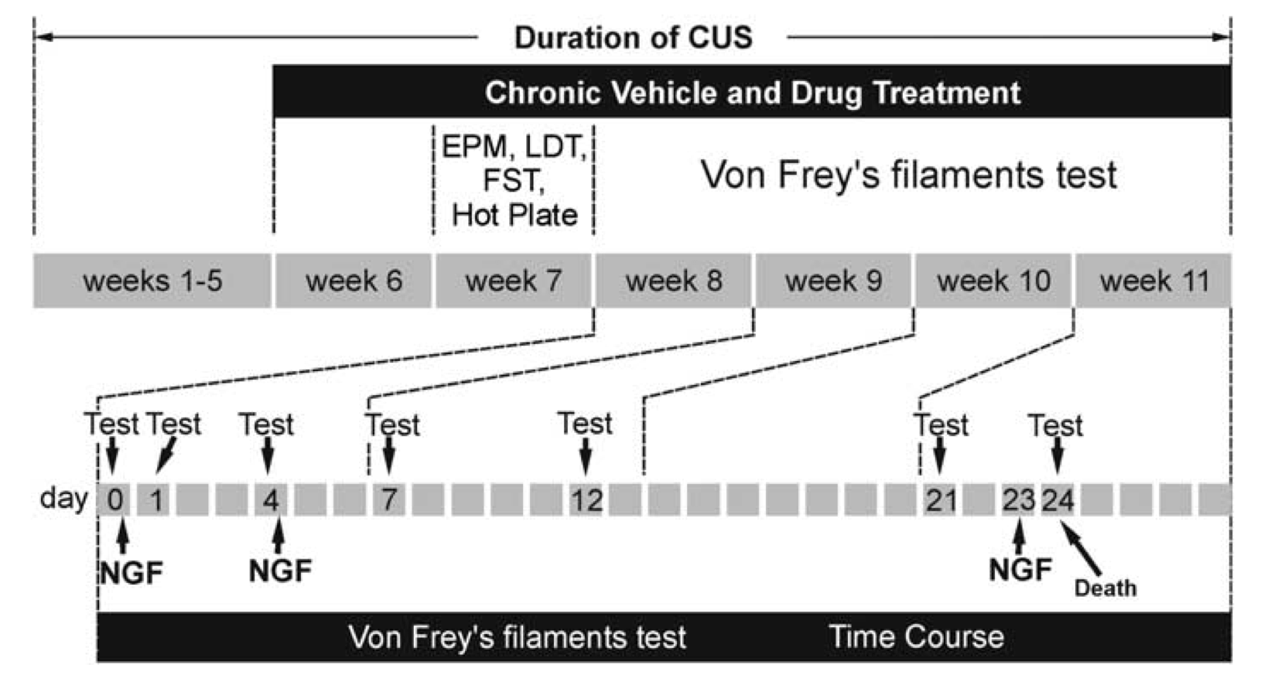
Notes:
C57BL/6J is the most widely used inbred strain and the first to have its genome sequenced. Although this strain is refractory to many tumors, it is a permissive background for maximal expression of most mutations. C57BL/6J mice are resistant to audiogenic seizures, have a relatively low bone density, and develop age related hearing loss. They are also susceptible to diet-induced obesity, type 2 diabetes, and atherosclerosis. Macrophages from this strain are resistant to the effects of anthrax lethal toxin.

Slide 26
Animal

Slide 27
2-AG and AEA metabolism
DAGL
MAGL
diacylglycerol
2-AG
arachidonic acid
NAPE-PLD
FAAH
NAPE
AEA
arachidonic acid

Slide 28

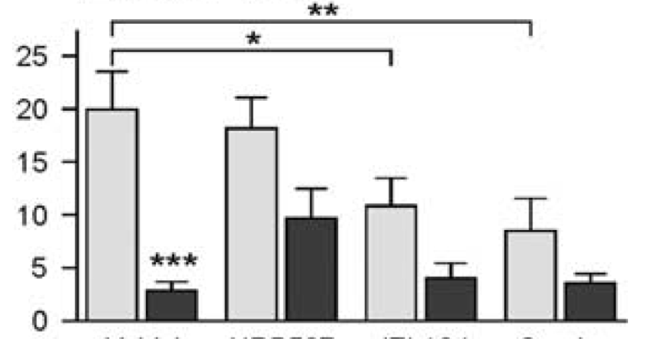
Time spend in open arms
2a
stressed
Chronic stress=> ⬆️ anxiety
Chronic stress+AEA=> ⬆️ anxiety
2-AG=> ⬆️ anxiety
2-AG+AEA=> ⬆️ anxiety
more anxiety
i.p.
AEA
i.p.
2-AG
AEA
+
2-AG
Control
√
√
√

Slide 29
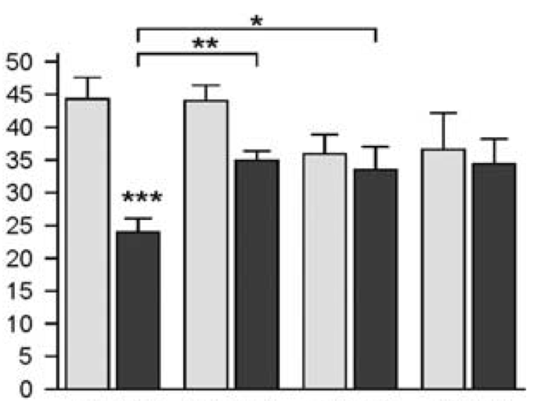
Time spend in light
2c
stressed
Chronic stress=> ⬆️ anxiety
Chronic stress+AEA=> ⬆️ anxiety
Chronic stress+2-AG=> ⬆️ anxiety
more anxiety
i.p.
AEA
i.p.
2-AG
AEA
+
2-AG
Control
√
√
√

Slide 30
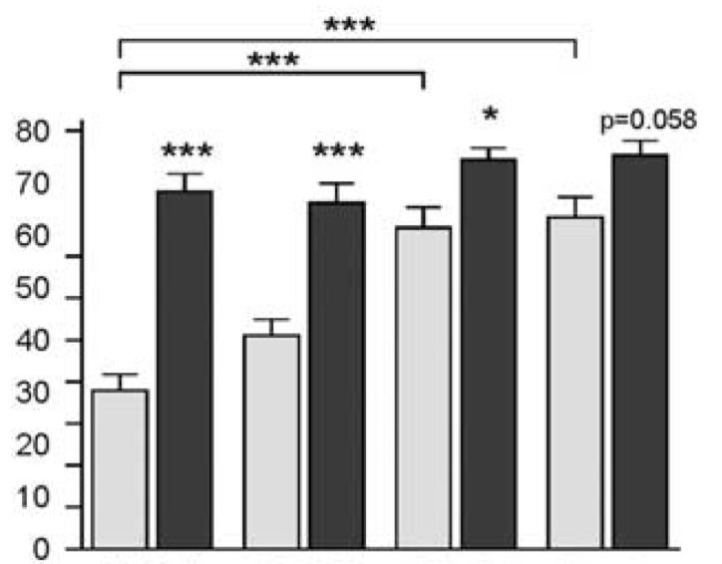
Immobility time
2e
stressed
Chronic stress=> ⬆️ anxiety
Chronic stress+AEA=> ⬆️ anxiety
Chronic stress+2-AG=> ⬆️ anxiety
2-AG=> ⬆️ anxiety
2-AG+AEA=> ⬆️ anxiety
more anxiety
i.p.
AEA
i.p.
2-AG
AEA
+
2-AG
Control
√
√
√

Slide 31
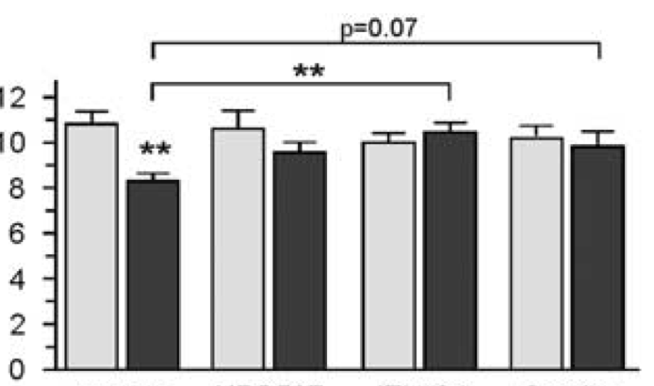
Latency to first reaction to heat (hot plate test)
2g
stressed
Chronic stress=> ⬆️ anxiety=>hyperalgesia
Chronic stress+2-AG=>
stress-induced hyperalgesia
Chronic stress+2-AG+AEA=>
stress-induced hyperalgesia
feel more painful
i.p.
AEA
i.p.
2-AG
AEA
+
2-AG
Control
√
√
√

Slide 32
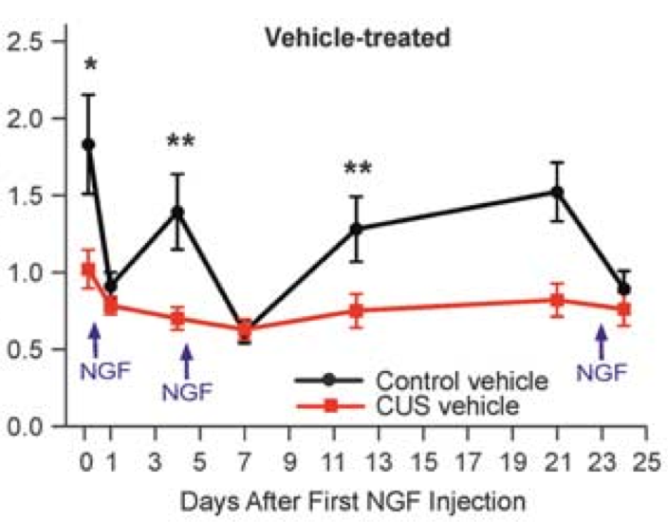
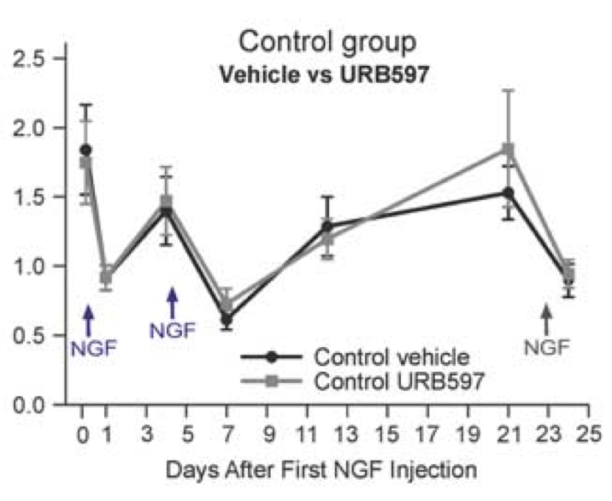
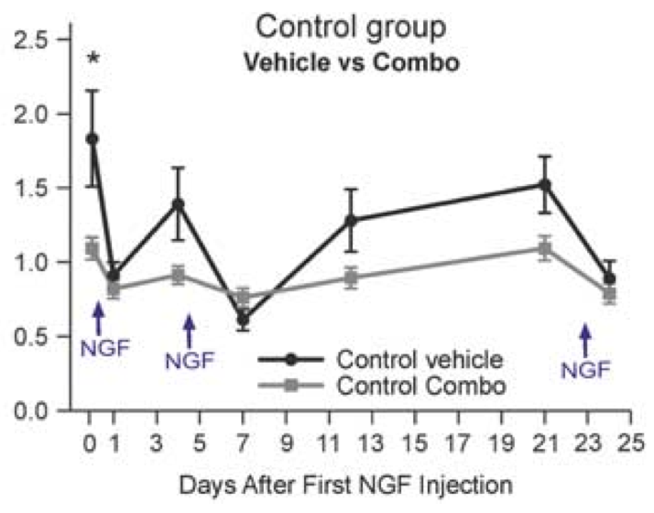
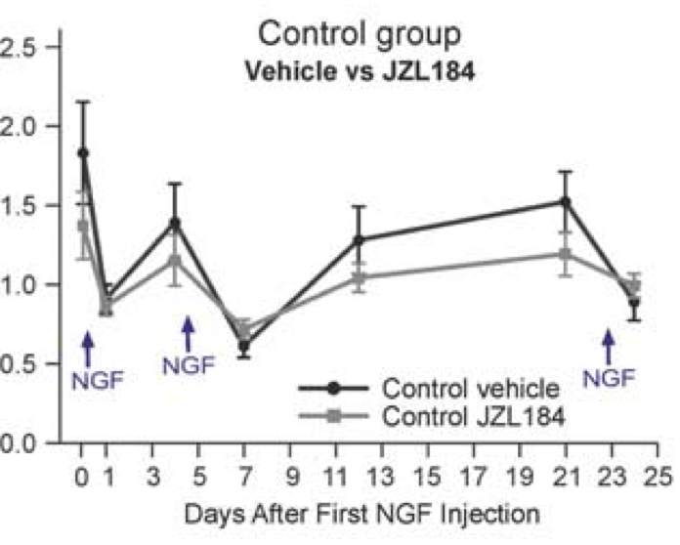
AEA
feel more painful
feel more painful
feel more painful
2-AG+AEA
feel more painful
2-AG

Slide 33
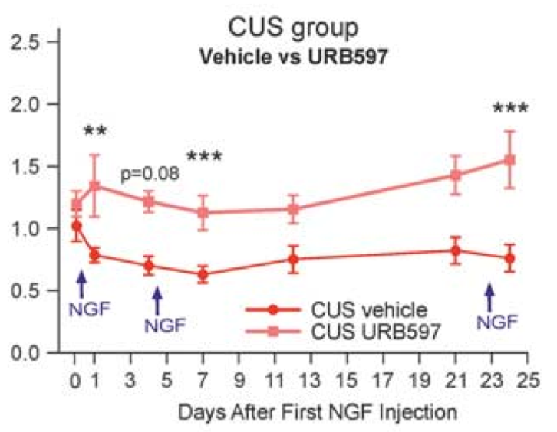
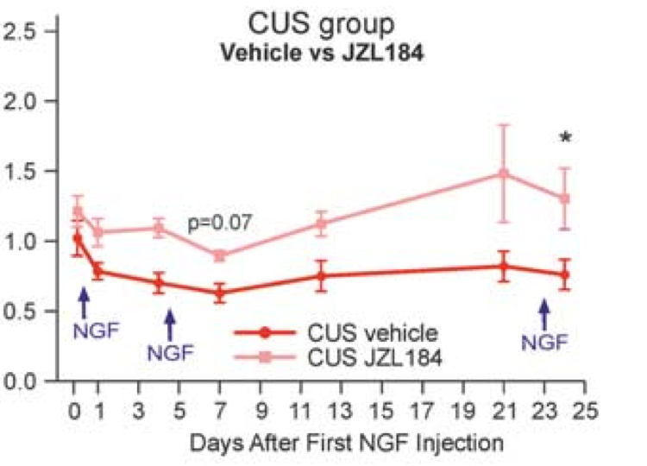
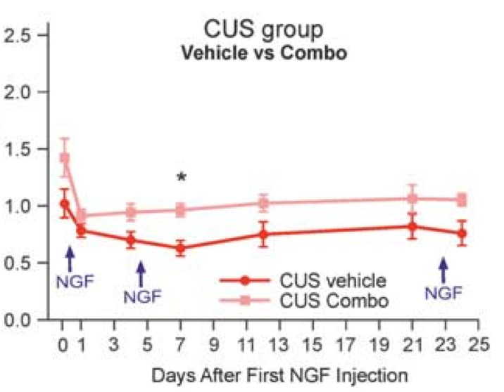
AEA
feel more painful
feel more painful
2-AG
feel more painful
feel more painful
2-AG+AEA

Slide 34
Summary
Mice exposure to chronic stress showed
    anxiety- and depression-like behavior
    thermal and mechanical hyperalgesia
AEA decreased mechanical hyperalgesia and anxiety-like behavior

Slide 35
Thank you!

