Slide 1
Definitions
Primitive = appearing earlier in the fossil record, ancestral character state
Derived = appearing later in the fossil record as a new evolutionary innovation, descendant character state
Clade = all organisms within a single evolutionary lineage; stemming from a common ancestor (can also be called a taxon)

Slide 2
Definitions (cont.)
Homology = specific organs or structures in different animal groups that have descended, with modification, from similar organs present in ancestors (e.g., mammal limb from fish fin)
Homologous structures in different animals result from inheritance from a common ancestor and arise from a common portion of the genome, so they can be used as evidence of evolutionary relatedness
Analogous structures = organs or structures having similar functions but not similar ancestry (e.g., wings of insects and birds; fish tail fin and whale fluke)
Can’t be used as evidence for evolutionary relatedness

Slide 3
Classification – General Features
Basic Unit of Classification = Species
Biological Species Concept = a group of similar-looking individuals capable of successfully interbreeding
Phylogenetic Species Concept = a genetically distinct group reproductively isolated from other such groups (i.e., gene flow restricted)
All concepts treat species as independent and closed genetic systems

Slide 4
Classification – General Features
Species are grouped into higher phylogenetic (taxonomic) units as well
Each successively higher unit contains fewer and fewer shared characteristics
Therefore, the higher the taxonomic unit, the less closely related are the organisms belonging to that unit
Goal of classification is to provide a correct phylogeny = evolutionary family tree of living and extinct organisms

Slide 5
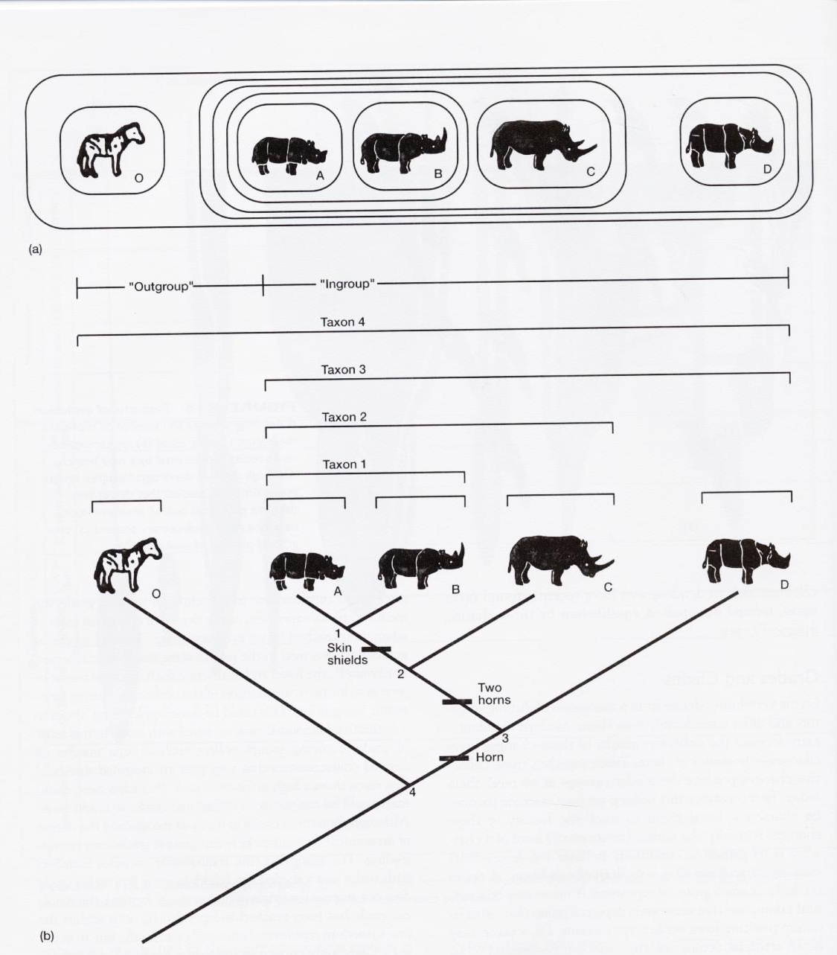
Derived
Characters
Primitive
Character
Hooves
Fig 1.27 – Classification Example

Slide 6
Classification System (General to Specific)
Classification System:
Domain (General category, few shared traits)
Kingdom
Phylum
Class
Order
Family
Genus
Species (many shared traits)

Slide 7
Classification – General Features
Relationships among higher clades (or at least which organisms belong to which clades) generally pretty well understood, but relationships among lower phylogenetic clades less well understood
Classification is dynamic, changing as new information is discovered
Currently, much revision in phylogenetic relationships is associated with recent molecular work (gene sequencing)

Slide 8
Chordate Origins
2 groups of organisms with a bilateral body plan (if split in two, get two halves that are mirror images):
Deuterostomes = blastopore (an opening occurring in early embryo) becomes anus; includes Echinoderms, Hemichordates and Chordates.
Protostomes = blastopore becomes mouth; includes Molluscs, Annelids, and Arthropods.
Recent molecular data have confirmed this division, which was originally based on differences in embryology.

Slide 9
Fig 2.3

Slide 10
Chordate Origins
Phylum Chordata = includes vertebrates and invertebrate chordates
Allied by the 4 chordate morphological characteristics (present in all chordates at some point during life cycle):
Notochord = stiff supporting rod along dorsal part of body, underneath dorsal nerve cord
Pharyngeal gill slits
Dorsal hollow nerve cord
Post-anal tail

Slide 11
General Chordate Characteristics
Fig 2.4

Slide 12
Chordate Origins
In addition to the morphological shared features (dorsal nerve cord, notochord, pharyngeal gill slits, postanal tail), all chordates have cells that produce thyroid hormones (endostyle or thyroid gland).
Endostyle = glandular groove in floor of pharynx involved in filter feeding
Thyroid hormones (tyrosine precursor; include bound iodine) necessary to maintain adequate growth, development, tissue differentiation and metabolic rate.
Evolutionary Trend: from clusters of cells (in endostyle) to discrete gland (thyroid)

Slide 13
Chordate Origins
Related Phylum Hemichordata = includes Pterobranchs (Class Pterobranchia) and acorn worms (Class Enteropneusta)
Pterobranchs = tiny, rare marine animals that form plant-like colonies; individuals project like small flowers at the end of a secreted tube (test)
Possess one pharyngeal gill slit, but no other chordate characteristics
Filter feed by ciliary action

Slide 14
Chordate Origins
Acorn worms = elongated worm-like animals that burrow in tidal mud flats
Anterior end with a proboscis (used in burrowing) followed by a collar (contains mouth). These structures also present in Pterobranchs.
Possess well-developed pharyngeal gill slits, but no truly homologous structures to other chordate characteristics
Also show a dorsal nerve cord (more or less hollow) in collar region, but this becomes more diffuse posteriorly (not a complete cord)
At base of proboscis is stomocord = stout patch of support tissue (not homologous to notochord)

Slide 15
Chordate Origins
HOX genes (genes involved in early development) produce reversed dorsal and ventral body pattern between chordates and all other animals, including Hemichordates

Slide 16
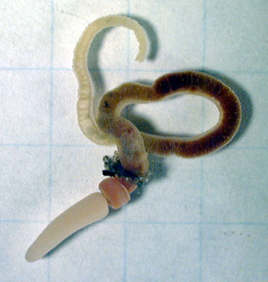
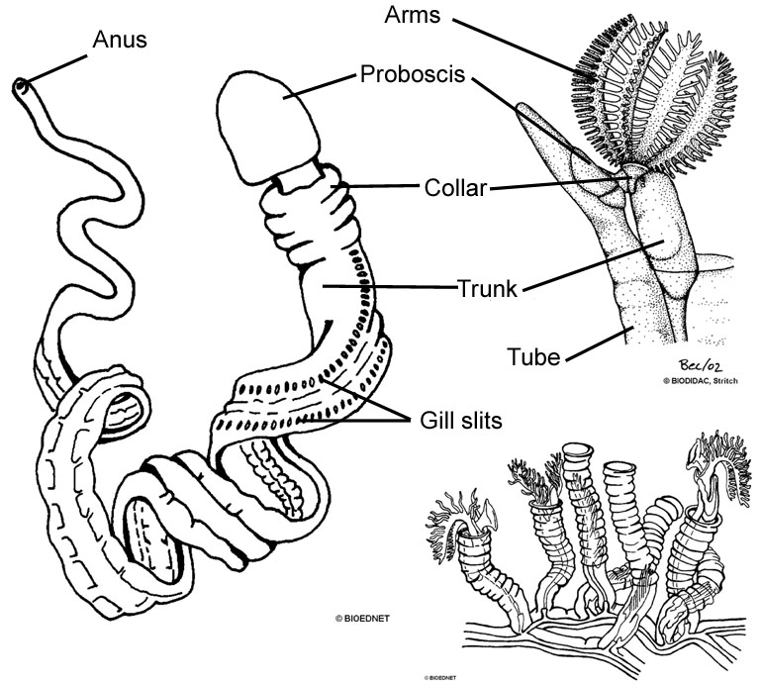
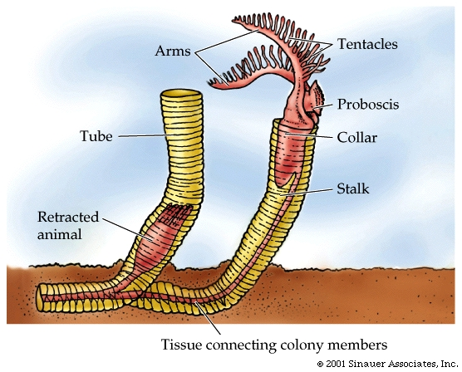
Acorn Worm
Pterobranch
Figs 2.8 & 2.14 – Hemichordates:
Acorn worms and Pterobranchs

Slide 17
Invertebrate Chordates
Phylum Chordata consists of 3 Subphyla:
Urochordata = tunicates or sea squirts
Cephalochordata = lancelets (amphioxus)
Vertebrata = vertebrates (or Craniata: comprised of hagfish + vertebrates)
Hagfish lack vertebrae around their notochord, so they have been separated out from the rest of the vertebrates in some classification schemes
Recent evidence suggests that hagfish have secondarily lost vertebral elements, so Vertebrata is current name for Subphylum

Slide 18
Urochordates (Tunicates)
Marine animals that may be solitary or colonial
Adults have sac-like shape with outer covering a “leathery” tunic (cellulose)
Filter feeders using pharyngeal gill slits; adults lack other chordate characteristics
Larvae are free-swimming and have all four chordate characteristics
Larvae metamorphose into sessile adults – notochord, dorsal nerve cord and post-anal tail degenerate

Slide 19
Figs 2.22 and 2.23 –
Urochordate larvae and
metamorphosis

Slide 20
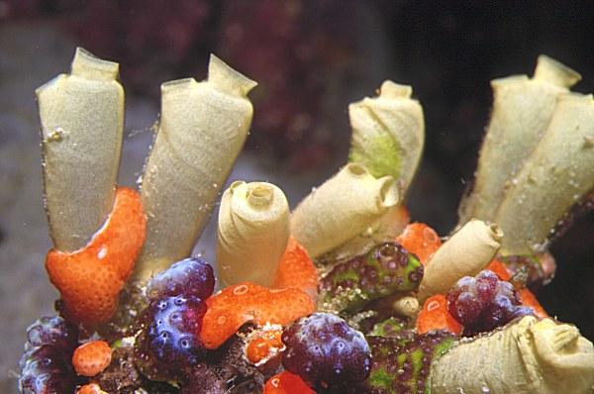
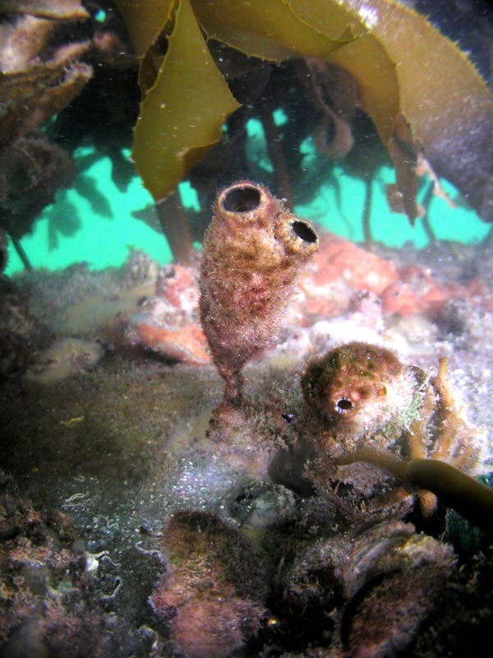
Fig 2.24
Adult Urochordates

Slide 21
Cephalochordates (Amphioxus)
Elongated, vaguely fish-like marine animals that live mainly buried in sand or silt with the head region protruding
They are capable of swimming
Filter feeders using pharyngeal gill slits
Possess all 4 chordate characteristics as an adult – so the most clearly related to the vertebrates among the invertebrate chordates, although genetic evidence suggests that they are the most basal of the chordates.
Possess segmentally arranged muscle masses (myomeres) in the lateral body walls. Similar to common condition in vertebrates
No paired fins present, only metapleural folds on ventral region of the body (lack of paired fins is similar to primitive fishes)

Slide 22
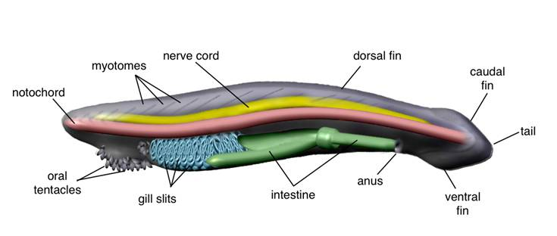
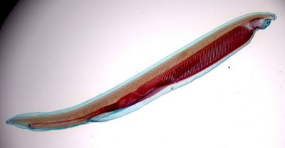
Fig 2.16
Cephalochordates

Slide 23
Vertebrata (Vertebrates)
Characterized by cephalization = concentration of nerve cells (into a brain) and sense organs in the anterior (head) region.
Necessary because vertebrates are active animals and need to perceive information from the front of the body as they move forward.
Possess vertebral column (backbone)
Specialized kidney tubules
Includes: Fishes, Amphibians, Reptiles, Birds, Mammals

Slide 24
Chordate Origins
General trend in Chordate evolution = increasing levels of activity, and to some extent, increasing body size
Chordate Ancestry:
Echinoderms (sea urchins, starfish) share similarities in embryonic development and larvae.
Hemichordates and Chordates perhaps evolved from a common ancestor, possibly like present-day echinoderm (Garstang’s Hypothesis) or hemichordate larvae via paedomorphosis (= retention of larval characteristics in sexually mature adult).
Recent molecular evidence offers little support for this view.

Slide 25
Fig 2.30 – Garstang’s Theory of the
Origin of the Chordate Body Plan

Slide 26
Chordate Origins
Current View: Genes involved in determining dorsal-ventral body plan function to produce opposite body plan in chordates and echinoderms & hemichordates
This inverted body plan was a major evolutionary innovation, but why it occurred is not known.
In any event, the chordate ancestor was probably a mobile bottom-dweller as an adult, that fed by ciliary/mucus feeding system
Development of pharyngeal gill slits improved feeding characteristics.
Other chordate characteristics likely arose to enhance locomotion abilities in chordate ancestors.

Slide 27
Fig 2.32

Slide 28
Vertebrate Origins
Vertebrate Ancestry:
One hypothesis (Garstang’s) proposes that larval form of urochordate (free-swimming with all 4 chordate characteristics) that normally transformed into a sessile adult, instead became sexually mature in the larval stage, or while retaining larval morphology (= paedomorphosis)
This retention of larval characteristics in a sexually mature stage occurs in one group of present-day Urochordates (Class Larvacea), so there is precedent for such a change.
The advantage of this lifestyle is that the organism could actively seek out favorable foraging opportunities.
This organism then likely led directly to Vertebrates (Cephalochordates are a sister clade)

Slide 29
Vertebrate Origins
Alternative Hypothesis:
A prechordate may have abandoned sedentary filter-feeding lifestyle to become actively predaceous.
This lifestyle favors development of chordate-like characteristics: notochord, muscular tail, dorsal hollow nerve cord.
Urochordates and Cephalochordates reversed this trend (reverted to sessile filter feeders), but vertebrates did not (continued toward active foraging lifestyle).

Slide 30
Evolutionary Scenario: Chordate/Vertebrate Origins
Early pre-chordates likely mobile, bottom-dwelling worms similar to Acorn Worms.
Pharyngeal gill slits evolve to aid in ciliary/mucus system of feeding.
Increases in locomotion to promote more active foraging may have led to appearance of other chordate characteristics that favor more efficient movement.

Slide 31
Evolutionary Scenario: Chordate/Vertebrate Origins
These changes led to primitive amphioxus-like body form:
Incipient predator with better differentiated head, pharyngeal gill slits, eyes, expanded mouth
OR
Active suspension feeder
From this ancestor invertebrate chordates and vertebrates diverged
Secondary loss of mobility to less active filter-feeding system (Urochordates and Cephalochordates)
Increase in activity and better developed predatory traits (Vertebrates)
Muscular pumps form to assist with filter feeding and allow for formation of gills for breathing in vertebrates

Slide 34
Early Vertebrate Evolution
Ciliary, suspension-feeding pre-vertebrate (likely somewhat similar to amphioxus)
Evolutionary development of muscular pharyngeal pumps and cartilage support of pharyngeal arches
Agnathan fish (lack jaws) using muscular pumps to create currents for filter-feeding
Evolutionary development of jaws allowed feeding apparatus that could select individual food particles of larger size
Gnathostome fish with jaws and active selection of food items (predation)

