Slide 1
4 Tissue Types in the Body
Epithelia = epidermis of skin, lining of tubes, glands
Functions in protection, absorption, secretion
Muscle = functions in providing movements within the body; contractile
Nervous = specialized for impulse conduction, serves as long-range communication system
Connective Tissue = functions in support, binding and protection of soft tissues; 2 general types …
CT Proper = binding function; includes tendons, ligaments, fascia
CT Supportive = support function; includes skeletal elements – cartilage and bone

Slide 2
Connective Tissue Characteristics
All CT contain …
Cells – many types, generally widely spaced
Fibers (protein) = collagen, elastic, reticular
Ground substance = glycoprotein, gel-like intercellular material
All CT embryonically derived from mesenchyme
Mesenchyme develops from mesoderm, or in a few cases, neural crest tissue

Slide 3
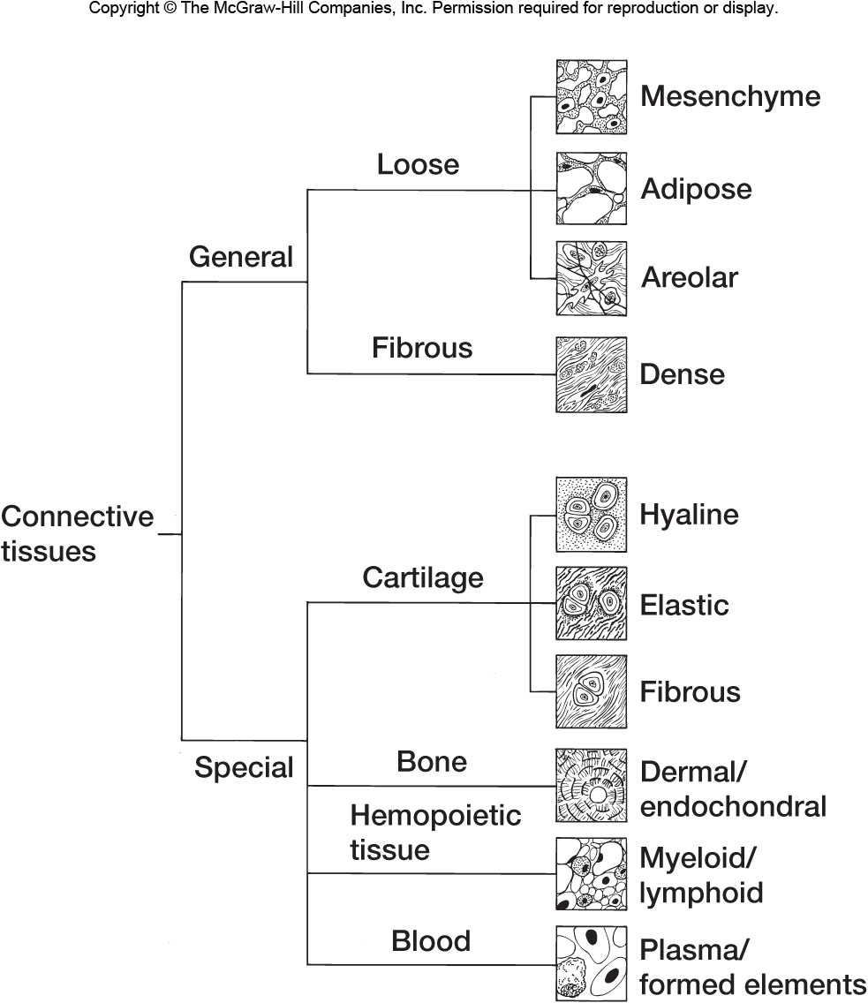
Fig 5.19 – CT Types
CT Supportive

Slide 4
Endoskeleton vs. Exoskeleton
Exoskeletons common in invertebrate animals, often formed from proteins (e.g., arthropods) or calcium-carbonate (e.g., molluscs)
In vertebrates, exoskeleton is limited to scales and dermal bones
Both are derivatives of skin
Dermal bones from dermatome portion of epimere (somite)
Exoskeleton becomes directly associated with endoskeleton (i.e., internal), although some early fishes retain external dermal bony armor (e.g., Ostracoderms, Placoderms).

Slide 5
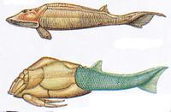
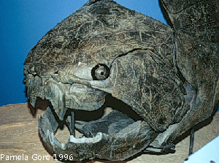
Armor composed of dermal bone covers
head region of many Ostracoderms (left)
and Placoderms (below)

Slide 6
Endoskeleton
Includes notochord, cartilage and bone
Notochord = present in all Chordates, at least in embryonic stage.
Largely replaced by vertebral column in all vertebrates except the most primitive (e.g., cyclostomes)
Recall that the hagfish lacks any vertebral development and retains an essentially complete notochord in the adult
Notochord composed of a distinctive, fluid-filled, vesicular CT, surrounded by an external fibrous sheath and a CT membrane

Slide 7
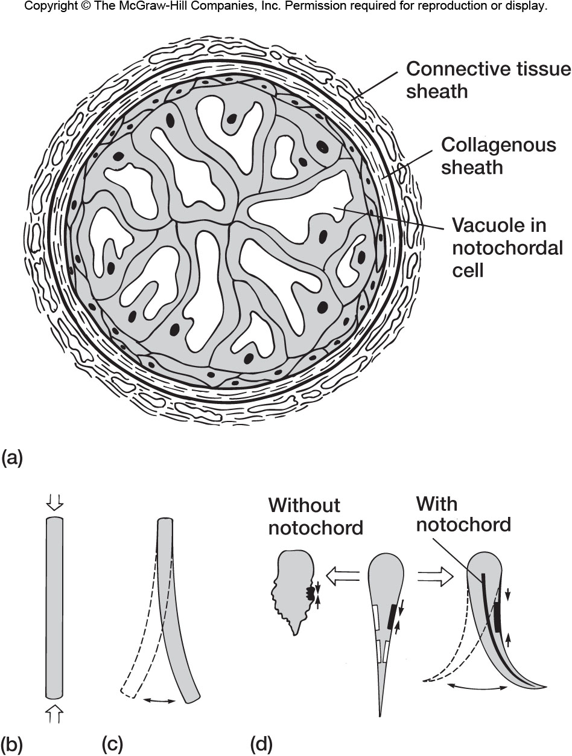
Fig 2.5 - Notochord

Slide 8
Notochord
Evolutionary Trend = from primitive to advanced vertebrates, notochord progressively replaced by vertebrae
Cyclostomes = present in adult as soft, flexible rod under neural tube. Little vertebral development in lampreys, none in hagfish
Elasmobranchs = shows alternate constrictions and expansions within and between vertebrae, but is complete
This condition applies to most fishes, Labyrinthodonts and some reptiles
Tetrapods = in most adults persists only as components of intervertebral discs between vertebrae

Slide 9
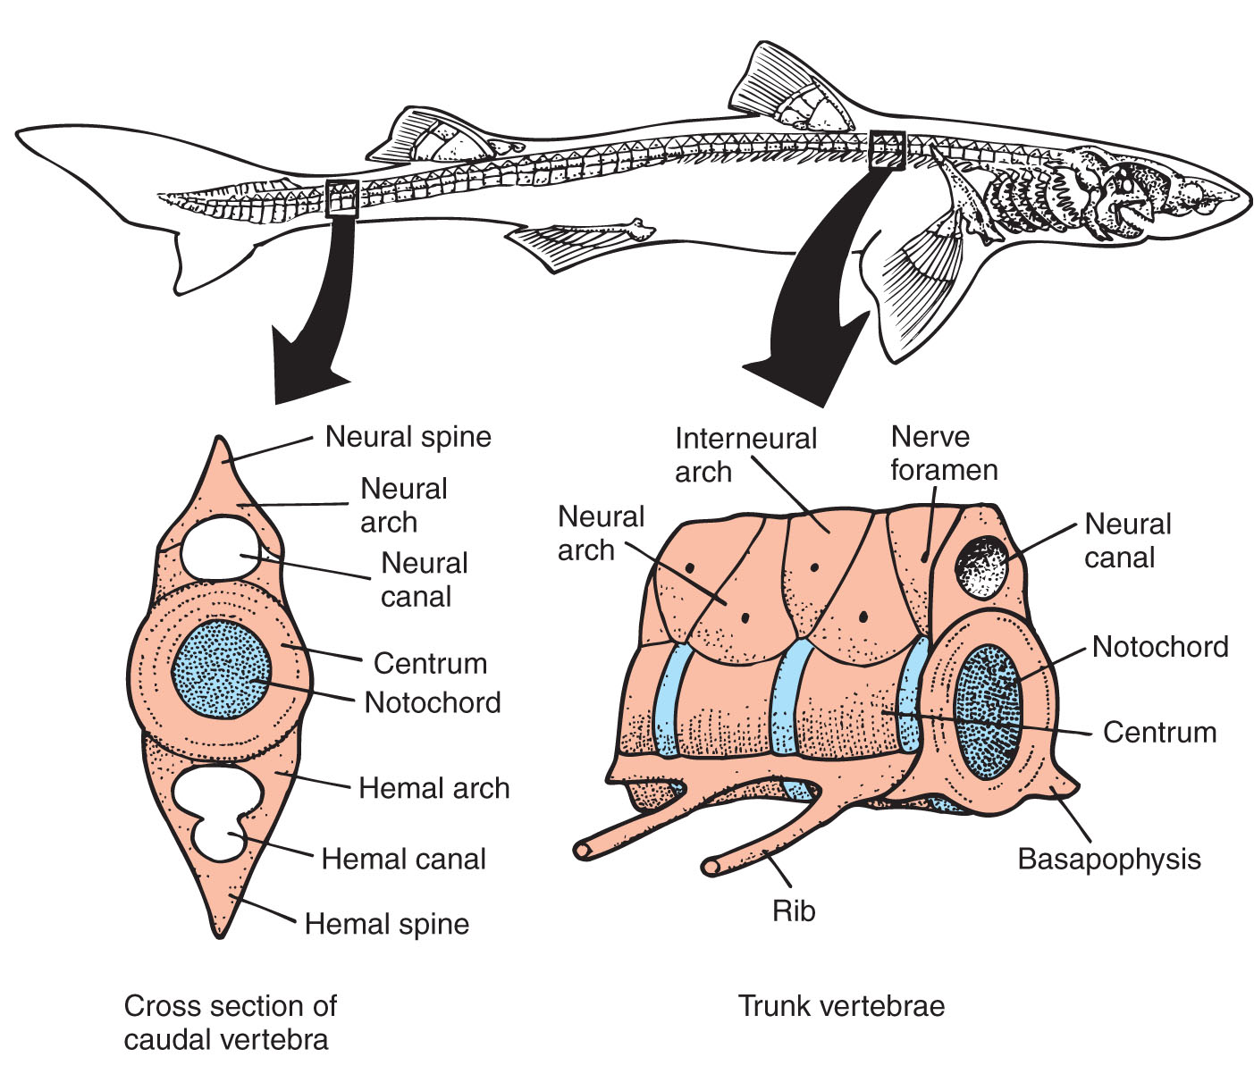
Fig 8.15 – Notochord condition in sharks

Slide 10
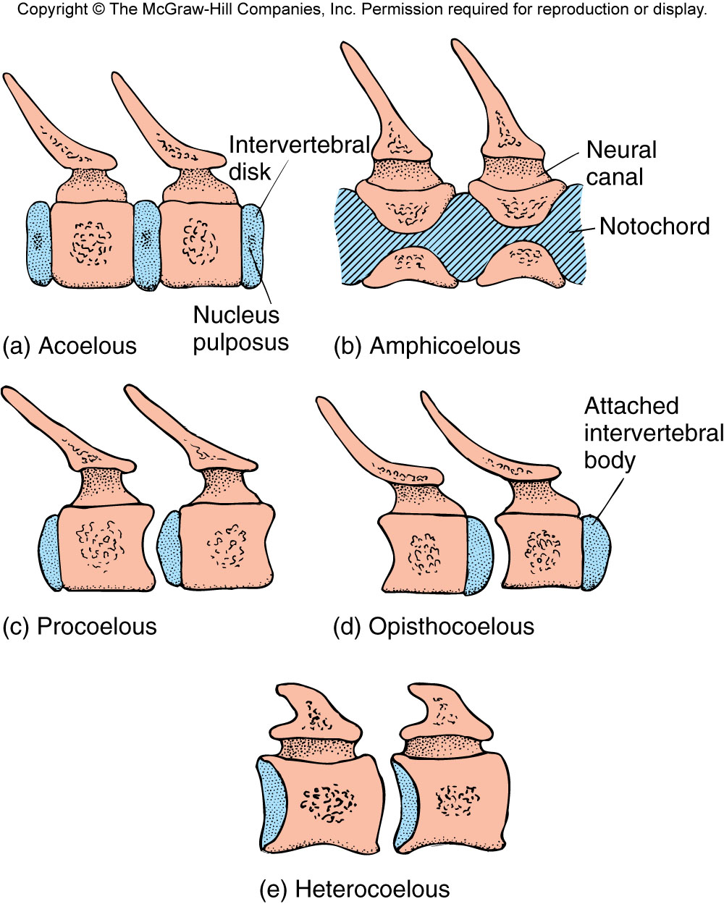
Fig 8.4 – Relationship between notochord and vertebral development in vertebrates

Slide 11
Cartilage
Present as the major skeletal element of embryonic vertebrates
Composed of CT with rubbery intercellular ground substance (glycoproteins, glycosaminoglycans)
Persists as adult cartilagenous skeleton only in cyclostomes, Chondrichthyes, and a few Osteichthyes
Some cartilage present in adults of all vertebrate groups, but in most advanced vertebrates plays only a minor role

Slide 12
Bone
Dominant skeletal material of most adult vertebrates.
Ground substance composed of crystalline calcium phosphate in which cells are embedded.
Calcium present as hydroxyapatite (calcium phosphate) crystals = 3Ca₃[PO₄]₂Ca[OH]₂

Slide 13
Bone Development
Intramembranous (Direct) = bone arises directly from mesenchyme.
Applies to dermal bones, generally produces spongy bone (although these may fill in to form compact bone)
Also produces sesamoid bones (= bones that develop within a tendon – patella, pisiform)
Endochondral (Cartilage Replacement) = cartilage develops from mesenchyme to form “model.” Bone replaces cartilage model.
Applies to the majority of skeletal elements and mostly produces compact bone

Slide 14
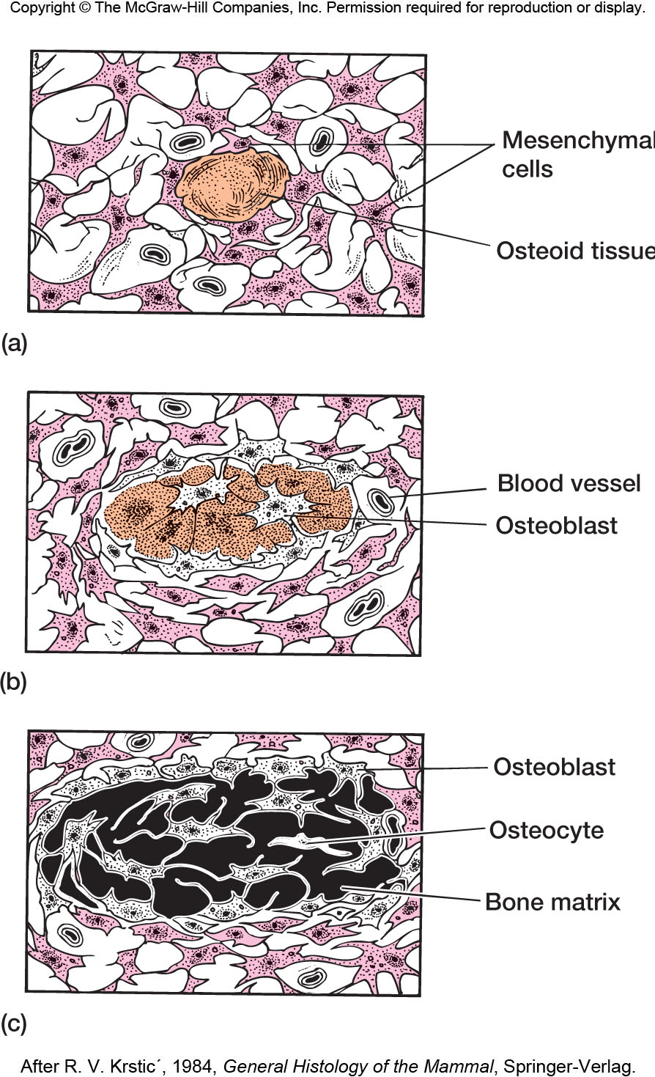
Fig 5.25 – Intramembranous
bone formation

Slide 15
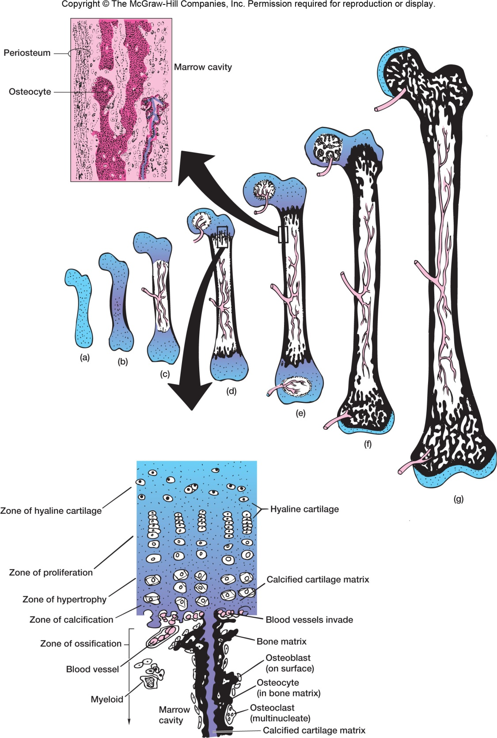
Fig 5.24 – Endochondral
bone formation

Slide 16
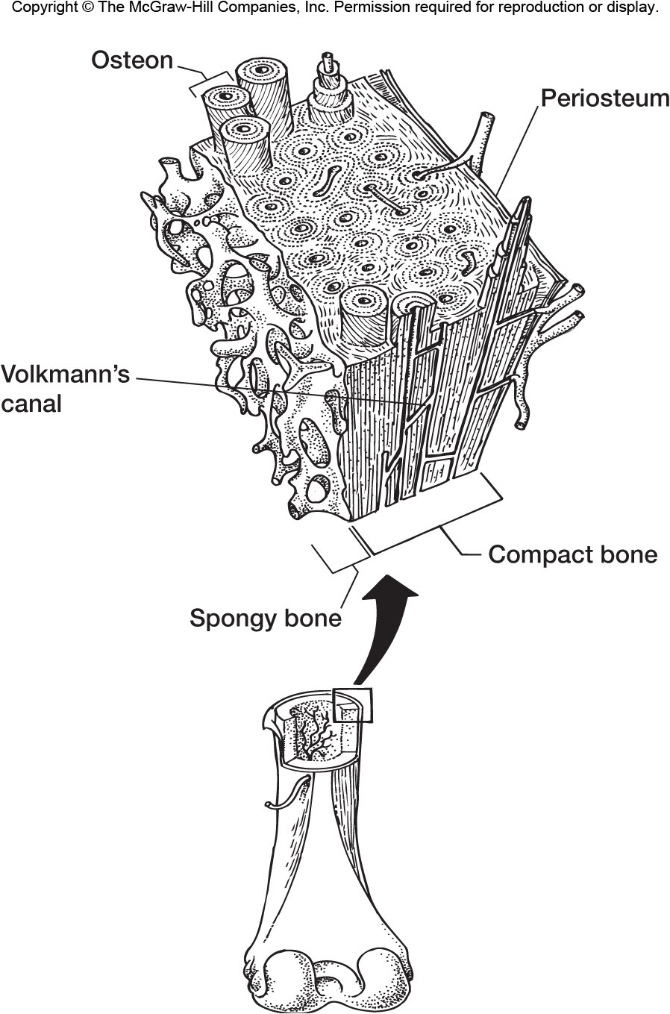
Fig 5.23 – Bone architecture: compact and spongy bone

Slide 17
Bone Development
Embryonically, bone is derived almost entirely from epimere (somite), although a few elements from neural crest.
Majority of bone derived from sclerotome.
Dermal bones derived from dermatome.
In primitive vertebrates, the myotome is the dominant part of the somite, sclerotome small and inconspicuous.
In amniotes sclerotome becomes much larger.

Slide 18
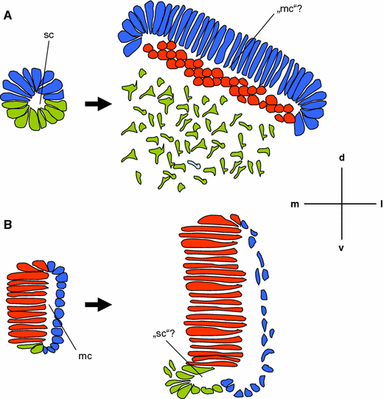
Scaal and Wiegreffe (2006).
Schematic representation of an amniote (a) and anamniote (b) somite. On the left; an early stage of somite development, showing the epithelial somite prior to overt morphological compartmental-ization. On the right; a mature somite showing distinct somite compartments. In red; myotomal cells. In blue; dermatomal precursor cells or dermatomal cells, respectively. In green; sclerotomal precursor cells or sclerotomal cells, respectively.
a The amniote epithelial somite (left) is divided into a dorsal half destined to form the dermomyotome, and a ventral half which will give rise to the sclerotome.
b The anamniote epithelial somite (left) is divided into a medial myotome and a lateral wall, which is thought to give rise to dermis and possibly muscle in later stages. It is likely to be homologous to the amniote dermatome. In the mature somite (right) the myotomal cells have differentiated to muscle fibers/lamellae in situ, the dermatomal cells have deepithelialized, and the sclerotome has formed an epithelial bud starting to form mesenchyme.
Amniote
Dermatome
Sclerotome
Myotome
Anamniote

Slide 19
Bone Organization
Orientation of collagen fibers and ordered placement of bone cells within bony matrix is useful means of classifying bone
Nonlamellar bone (= fibro-lamellar bone) = characterized by irregular arrangement of collagen fibers in matrix
Occurs in fast-growing bone
Lamellar bone = regular arrangement of collagen fibers in matrix, accompanied by regular orientation of bone cells.
Occurs in slow-growing bone
Lines of Arrested Growth = regions in bone where growth ceases
Often due to seasonal activity (interruptions in growth due to environmental stress – cold weather for ectotherms)
More common in ectotherms, but also occurs in some endotherms

Slide 20
Bone Organization
Haversian bone = arrangement of bone into Haversian systems or osteons
Osteons consist of concentric rings of bone surrounding a central Haversian canal with bone cells between rings
Haversian canal contains blood vessels and canaliculi connect bone cells to Haversian canal so that cells can receive oxygen and nutrients
Volkman’s canals run perpendicular to Haversian canals to bring in blood vessels from outside the bone

Slide 21
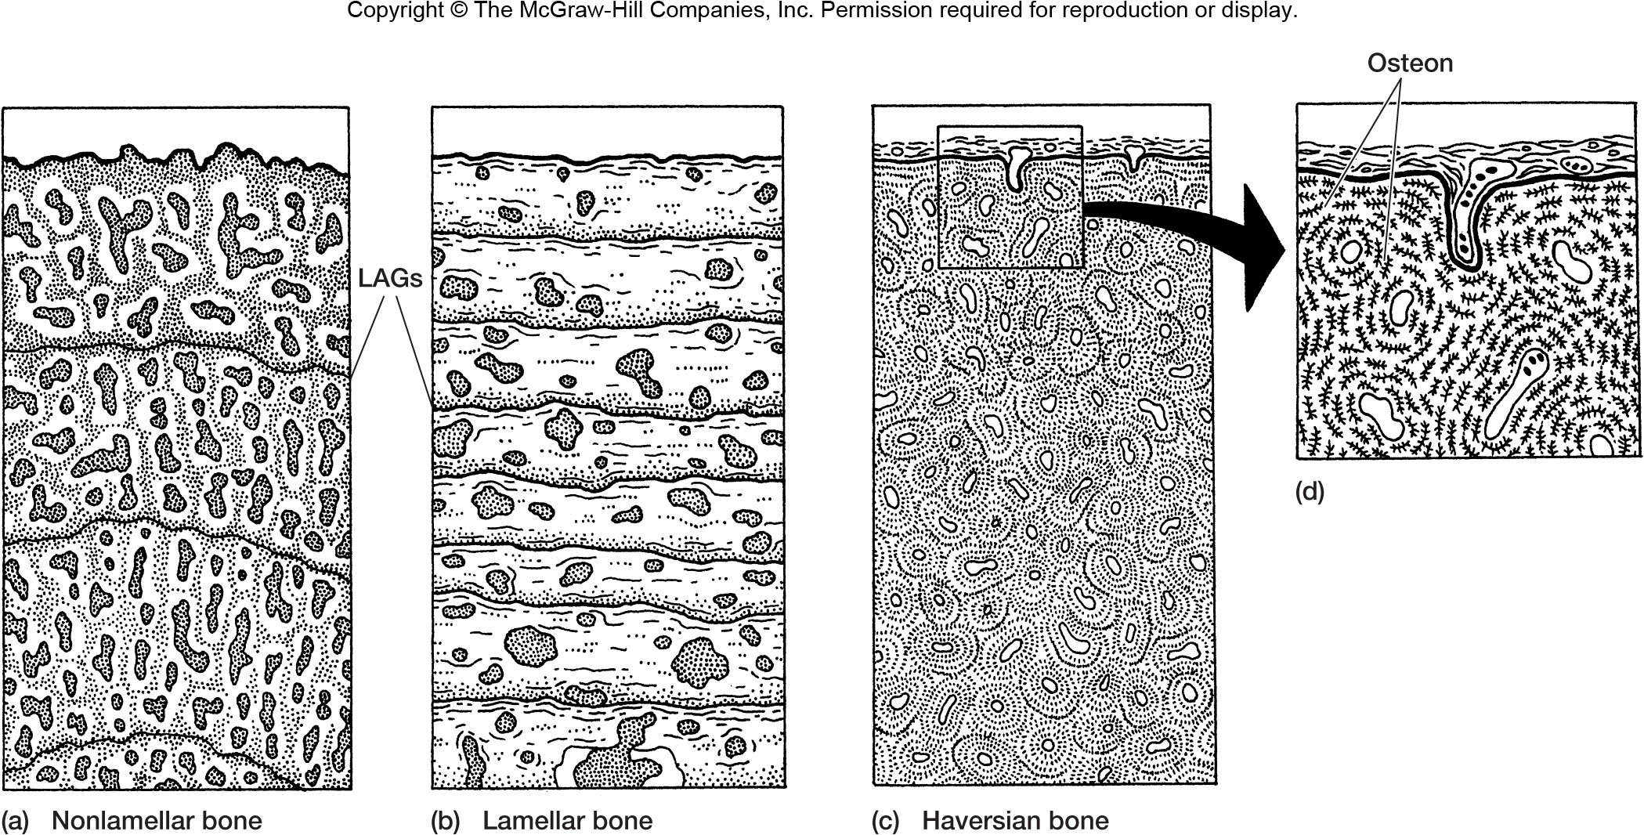
Fig 5.22 – General Bone Types. (a) non-lamellar (fibro-lamellar) bone from young alligator, (b) lamellar bone from turtles (note growth rings); (c) Haversian bone (= specialized form of lamellar bone)

Slide 22
Dinosaurs: Ectotherms or Endotherms The Evidence from Bone Histology
See Box Essays 3.4 and 3.6
Bone Histology was a primary source of evidence in initial arguments in 1980s and 1990s that dinosaurs were endothermic
Argument: microarchitecture of dinosaur fossil bones lacked regular growth rings typical of ectotherms in seasonal environments → similar to birds and mammals; suggests constant T_{b} year-round
Suggestion = dinos were endotherms like birds and mammals with high MR and lifestyles characterized by sustained activity

Slide 23
Dinosaurs: Ectotherms or Endotherms The Evidence from Bone Histology
Problems:
Many early birds (supposedly descendant from Coelurosaurian Theropod dinosaurs) had bones with growth rings, like ectotherms
Many dinos also have bone with growth rings, although fewer growth rings than in typical reptiles
Constant T_{b} (homeothermy) does not necessarily equate to endothermic MR
Large dinos in warm Mesozoic climates would likely have shown little T_{b} variation throughout the year even if ectothermic – inertial homeotherms

Slide 24
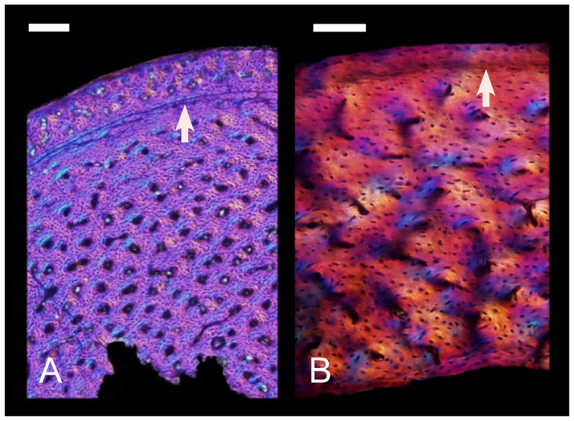
Coelurosaur
Erickson et al 2009
Cretaceous Bird
Note high degree of vascularization and woven bone structure in both species.
The coelurosaur image shows a line of arrested growth (arrow).

Slide 25
Dinosaurs: Ectotherms or Endotherms The Evidence from Bone Histology
Similarity in bone structure between dinosaurs and birds is likely related to fast growth rates.
Smaller dinosaurs and earliest birds show bone more typical of general reptilian bone, suggesting slower growth rates than in larger forms and slower than in modern birds.
Thus, fast growth rates are correlated with large size, not endothermy, so bone histology does not provide convincing evidence that dinosaurs were endotherms.

Slide 26
Classification of Skeletal Elements
Dermal Components Axial
Skeleton Somatic
Endoskeletal Components Appendicular
Visceral

Slide 27
Classification of Skeletal Elements
Dermal Components = arise in the skin (dermis - dermatome) via intramembranous formation.
Includes bony armor, scales (fish), elements of pectoral girdle and skull in all groups (except cyclostomes), and jaw bones (tetrapods)
Somatic Endoskeletal Components = cartilage-replacement bone from sclerotome
forms majority of internal structures
Visceral Endoskeletal Components = associated with gill arches and derivatives.
Derived from neural crest cells, so the only non-mesodermal instance of bone development.
Includes some jaw bones, hyoid apparatus, columella, bones of middle ear in mammals, bones supporting gills in fish.

Slide 28
Classification of Skeletal Elements
Axial Skeleton = Vertebral column and associated structures, including parts of skull, ribs, etc.
Appendicular Skeleton = limb girdles and elements of appendages

Slide 29
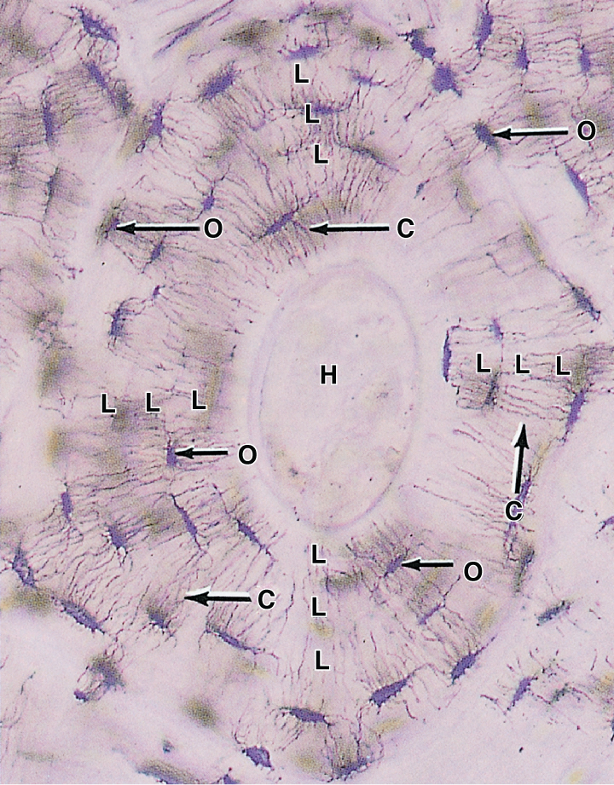
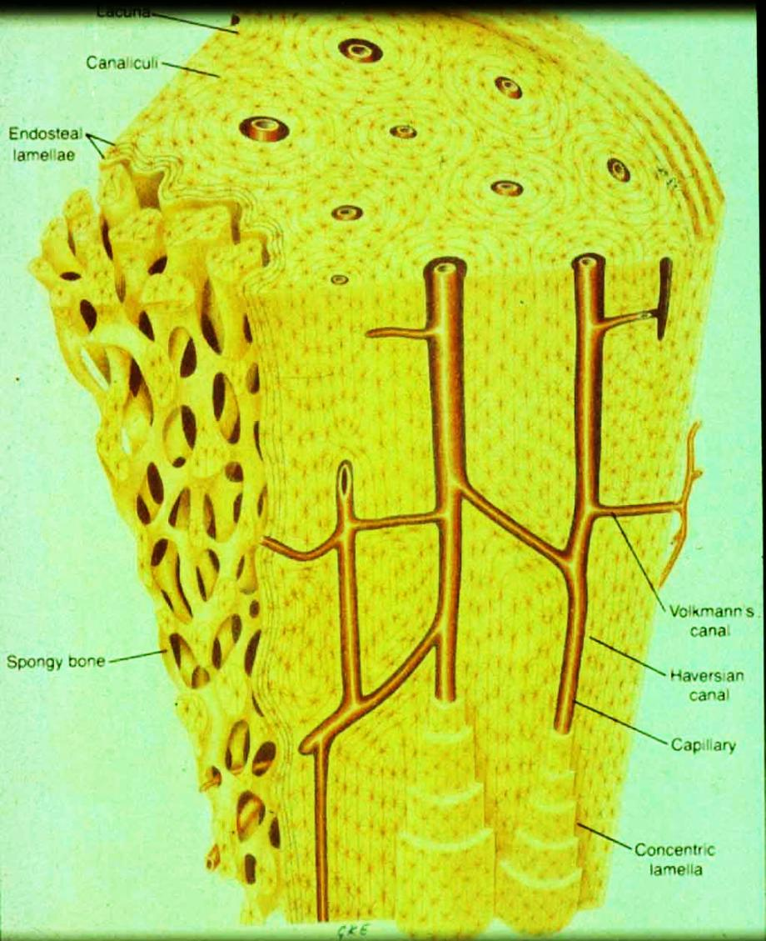
Haversian Bone
L = lamellae
O = osteocytes (in lacunae)
C = canaliculi
H = Haversian canal

Slide 30
Histophysiology of Bone
Intramembranous and Endochondral formation both result in identical ultrastructure – contains cells surrounded by bony matrix, but interconnected with other cells and with blood vessels by tiny canals (canaliculi).
Because of cellularity, adult bone is not a static tissue, but continuously adapts to prevailing stresses by appropriate deposition and resorption.
Also capable of repair if broken
Deposition and Resorption are under hormonal control – integrated with Calcium and Phosphate requirements within the body.
Bone serves as a storage tissue for both ions.

Slide 31
Fig 5.27 – Repair of broken bones. (a) blood clot forms, (b) cartilage invades break, (c) osteogenic bud invades cartilage forming woven bone, (d) remodeling produces healed bone structure

Slide 32
Histophysiology of Bone
Hormones controlling deposition and resorption also control blood calcium levels.
Parathyroid Hormone = promotes resorption, increases blood calcium
Calcitonin = reduces resorption, decreases blood calcium
Intense activity increases blood lactic acid levels (decreases pH) and causes dissolution of bone and calcium release.
May be important for muscular contraction.

Slide 33
Evolution of Skeletal Structure
Because bone is not present in any non-vertebrate chordates, it almost certainly was not present in the most primitive vertebrates.
In the earliest fossil vertebrates (ostracoderms) bone forms only a superficial armor (composed of dermal bone). There is no evidence of an ossified endoskeleton.
An ossified endoskeleton developed later than ossification of the exoskeleton, but has become the dominant feature in modern vertebrates, along with a reduction in dermal bone.

Slide 34
Evolution of Skeletal Structure
Why Ossify Skeleton with Calcium Phosphate (Calcium Carbonate in all Invertebrates)?
Hypothesis # 1 – Protection
Bone is harder and stronger than calcium carbonate so forms a more effective skeletal tissue. However, this seemingly is an equally good selective pressure for invertebrates – thus, it is likely that the protective function of hydroxyapatite bone is a secondary function.
So, what selective factor led to the evolution of hydroxyapatite bone instead of calcium carbonate, as in the exoskeleton of invertebrates?

Slide 35
Evolution of Skeletal Structure
Why Ossify Skeleton with Calcium Phosphate (Calcium Carbonate in all Invertebrates)?
Hypothesis # 2 – Metabolic Reserve with Structural Integrity
Evolution in vertebrates is characterized by increased activity levels. Increased activity leads to lactic acid buildup and to bone dissolution.
Hydroxyapatite is much more stable when exposed to lactate than is calcium carbonate.
So, evolution of hydroxyapatite bone was probably to allow a metabolic reserve of calcium and phosphate ions while still maintaining structural integrity during activity.

Slide 36
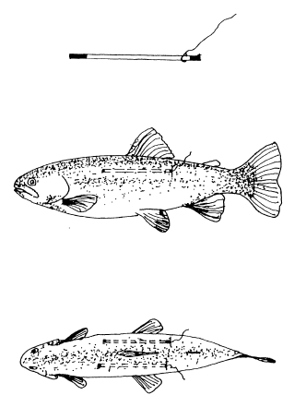
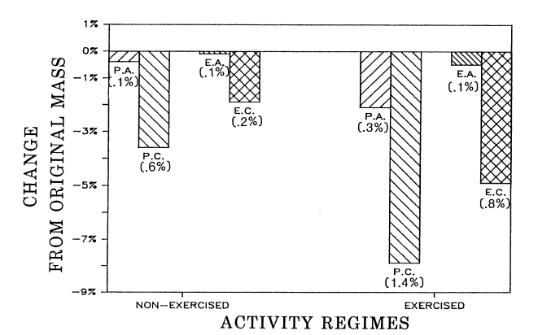
From Ruben and Bennett (1987, Evolution 41:1187-1197)
Implanted “silastic bones” composed of calcium carbonate(calcite) or calcium phosphate (apatite) into trout (also implanted crystals directly into peritoneum)
Exercised vs. Non-exercised (control) treatments
Exercised group showed increased loss of crystals compared to controls, and calcite showed greater reduction than apatite
Conclusion: Apatite more stable under low pH typical of exercise in vertebrates.
P = peritoneal crystals
E = silastic “bones”
A =apatite (calcium
phosphate)
C = calcite (calcium carbonate)

